Slide 1
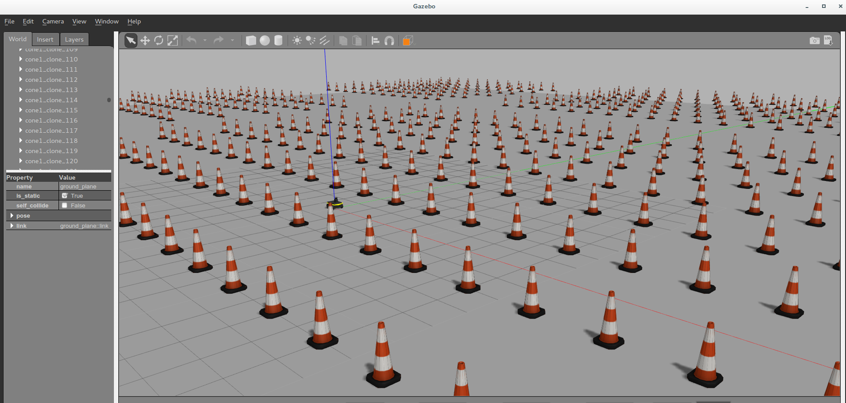
The effect of orchard heterogeneity on navigating an autonomous vehicle for agricultural tasks
Submits: Liron Shenkar
Supervisors Prof. Amir Degani , Omer Shalev

Slide 2
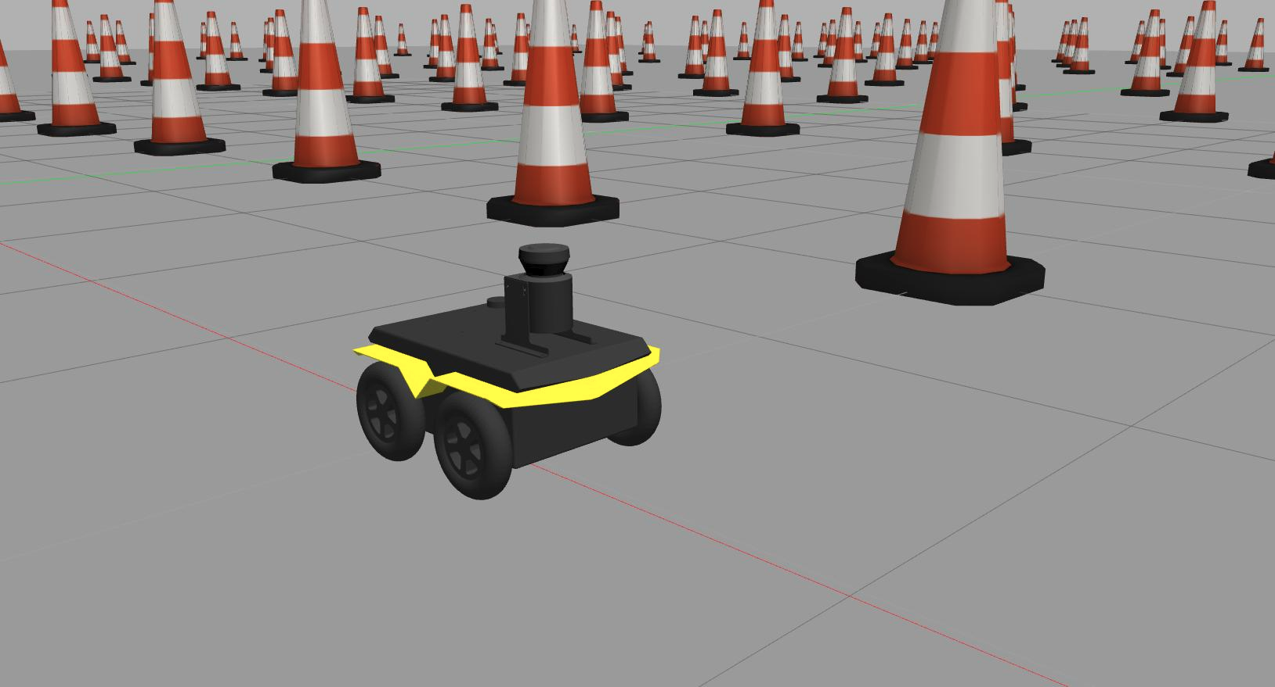
Project Highlights
Project Goal: To examine the performance of AMCL global localization algorithm under various heterogeneities of orchards of cones & cylinders.
The AMCL (Adaptive Monte Carlo Localization) algorithm is a version of a particle filter.
Like any localization algorithm, It gets a map of the area of interest (called “ground truth”) and some measurements (laser scan).
Having both, the algorithm shall try to find the robot’s location on the map ,which is called “hypothesis”. The robot is CLEARPATH® jackal.
Like humans, localization algorithms seek for some distinguishable landmarks in the area (“anchors”) in order to locate themselves on the given map.
The higher the homogeneity
of the area-the harder it is to
deliver good localization results.
We wish to know how exactly
homogeneities
influences AMCL performance.

Slide 3
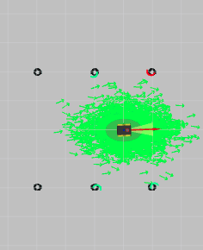
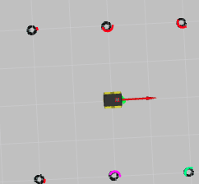
Project Highlights
A detailed info about AMCL implementation in ROS can be found here
http://wiki.ros.org/amcl
The AMCL implementation has two modes of operation:
Local localization
  The default mode of the AMCL algorithm whenever it is being invoked. Besides the map and the laser scan, the algorithm’s optional inputs are:
      Initial robot’s pose in meters [x,y,z].
      Initial 6X6 Covariance matrix (x, y, z, rotation about X axis, rotation about Y axis, rotation about Z axis). This matrix states the amount of uncertainty of the initial position and rotation of the robot.
      The covariance can be visualized in 2D in Rviz as an elliptical particle could. Seen below is a particle cloud of [0.5,0.5] covariance matrix (other matrix values were zeroed) Vs a very small particle cloud concentrated under the robot:
      The particle cloud corresponds to the area
      in which the robot might be with
      high probability

Slide 4
Project Highlights
Local localization (Cont.)
The output of the algorithm is the robot’s location on the map (hypothesis) . It is seen in Rviz simply as the jackal (see previous slide).
Just as the input, the output (hypothesis) of the algorithm is always attached to a covariance matrix, which states (again) the amount of its uncertainty .
Local localization is not really practical. The main reasons are:
    The search is local-only around the area of the relatively small covariance matrix.
    It tends to converge quickly and stick to the given initial pose, whether it is true or not. It does so even when the map and the measurements disagree with the hypothesis.
Global localization
  Global localization is useful especially for cases In which the robot does not have any prior knowledge about its position/orientation. An example can be a sudden shut off of the robot in the middle of the orchard,or when the robot was carried by someone to a new position (“the kidnapped robot” problem).
  Invoked by the user by calling a service : rosservice call /global_localization. It runs “on top” of the local search and does not get pose/covariance of its own. All the algorithm parameters are defined in the amcl.launch file, inside the navigation pack.

Slide 5
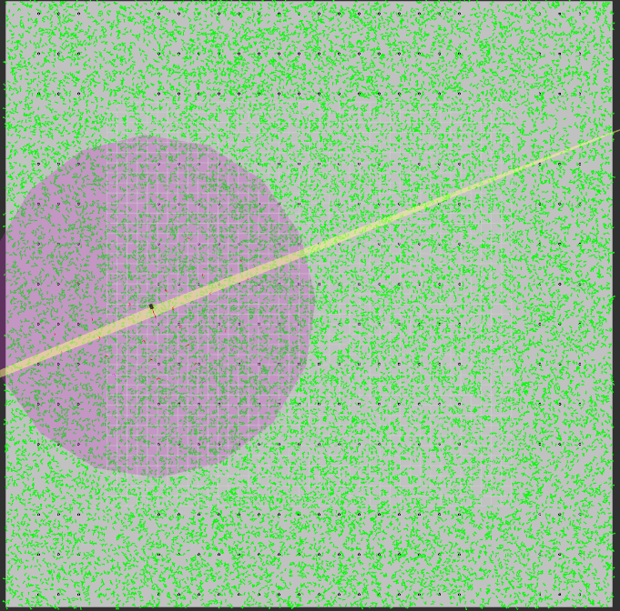
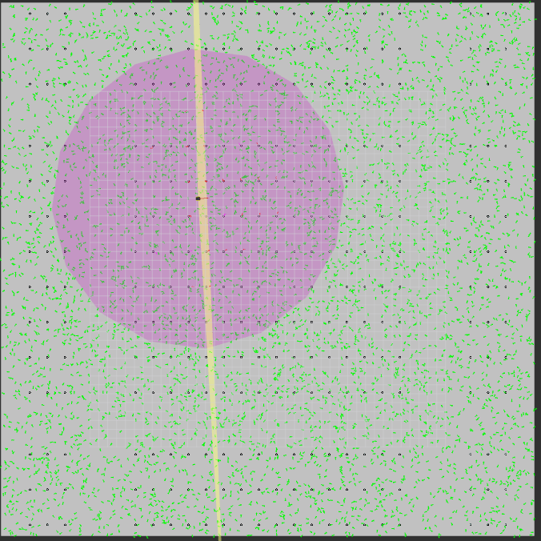
Project Highlights
Global localization (Cont.)
The most important parameter is the "max_particles" . It determines the maximum number of particles used by the algorithm. It is the only parameter I changed.
When the global_localization service is being called, A particle cloud of max_particles size covers uniformly the entire map.
Initial or current estimated pose & covariance matrix are ignored. Global search is a “new game”- Only the map and the laser scan are taken into account, past knowledge Is overridden.
During search, the uniformly-distributed particle cloud changes its shape until convergence, when only a very small cloud, just under the robot’s estimated location, remains. The images below shows clouds of 40K & 10K particles, uniformly distributed.
40K particle cloud
10K particle cloud

Slide 6
Project Highlights
Global localization (Cont.)
The pink area and the yellow triangle seen below (in Rviz) are the current best estimated position and orientation ,respectively.
Local search is not the scope of this work. I only focused on the global search algorithm performance under various heterogeneity conditions. The only parameter that was changed was the maximum number of particles.
In order to be consistent the global search was initiated right at the beginning of the simulations (there here are more reasons which are detailed later).
40K particle cloud
10K particle cloud

Slide 7
Project Highlights
Experiments methodology
Each experiment is a series of simulations over a Gazebo world.
Definitions of success/failure in a simulation
  Success- Algorithm finds true pose(X AND Y coordinates) & true orientation.
  Partial success- Algorithm finds true X OR Y coordinates & true orientation.
  Failure- Algorithm finds Neither true X Nor Y coordinates.
Each simulation was repeated several times, usually between 5-10. Why? -->
Successive simulations over the same world do NOT necessarily yield the same results.
Some of the reasons are:
    Odometry noise and errors are not identical in all simulations.
    Measurement noise is also not identical.
    The AMCL algorithm is statistical in nature. The re-sampling process and the distribution of the particle cloud in each step aren’t deterministic.
In the end, the results are summed , and the success rate of each experiment is calculated.

Slide 8
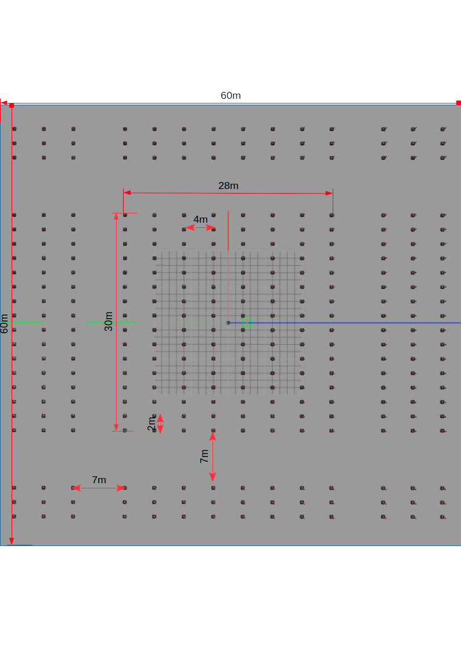
Project Highlights
The world

Slide 9
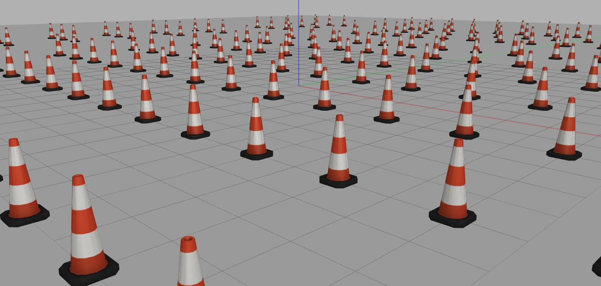
Project Highlights
The basic (homogeneous) world was created in Gazebo 7.2 , exploiting the “Population of models” feature, which was not available prior to gazebo 7.0.
“Population of models” enables to create collections of models easily. It offers a simple and accurate way of creating structures of rows,columns and arrays of the same model.
In order to make modifications of the basic world, changes can be made directly on the world file, or via the Gazebo GUI ( and then saving the modified world).
For more information see http://gazebosim.org/tutorials?tut=model_population&cat=

Slide 10
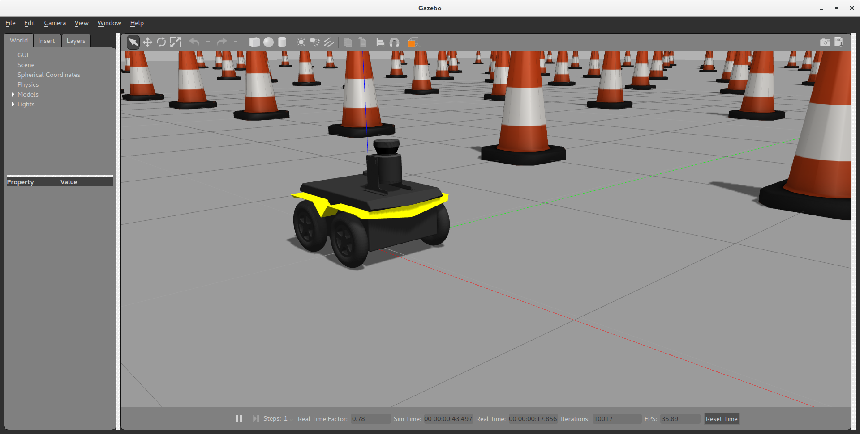
Experiments
Experiments

Slide 11
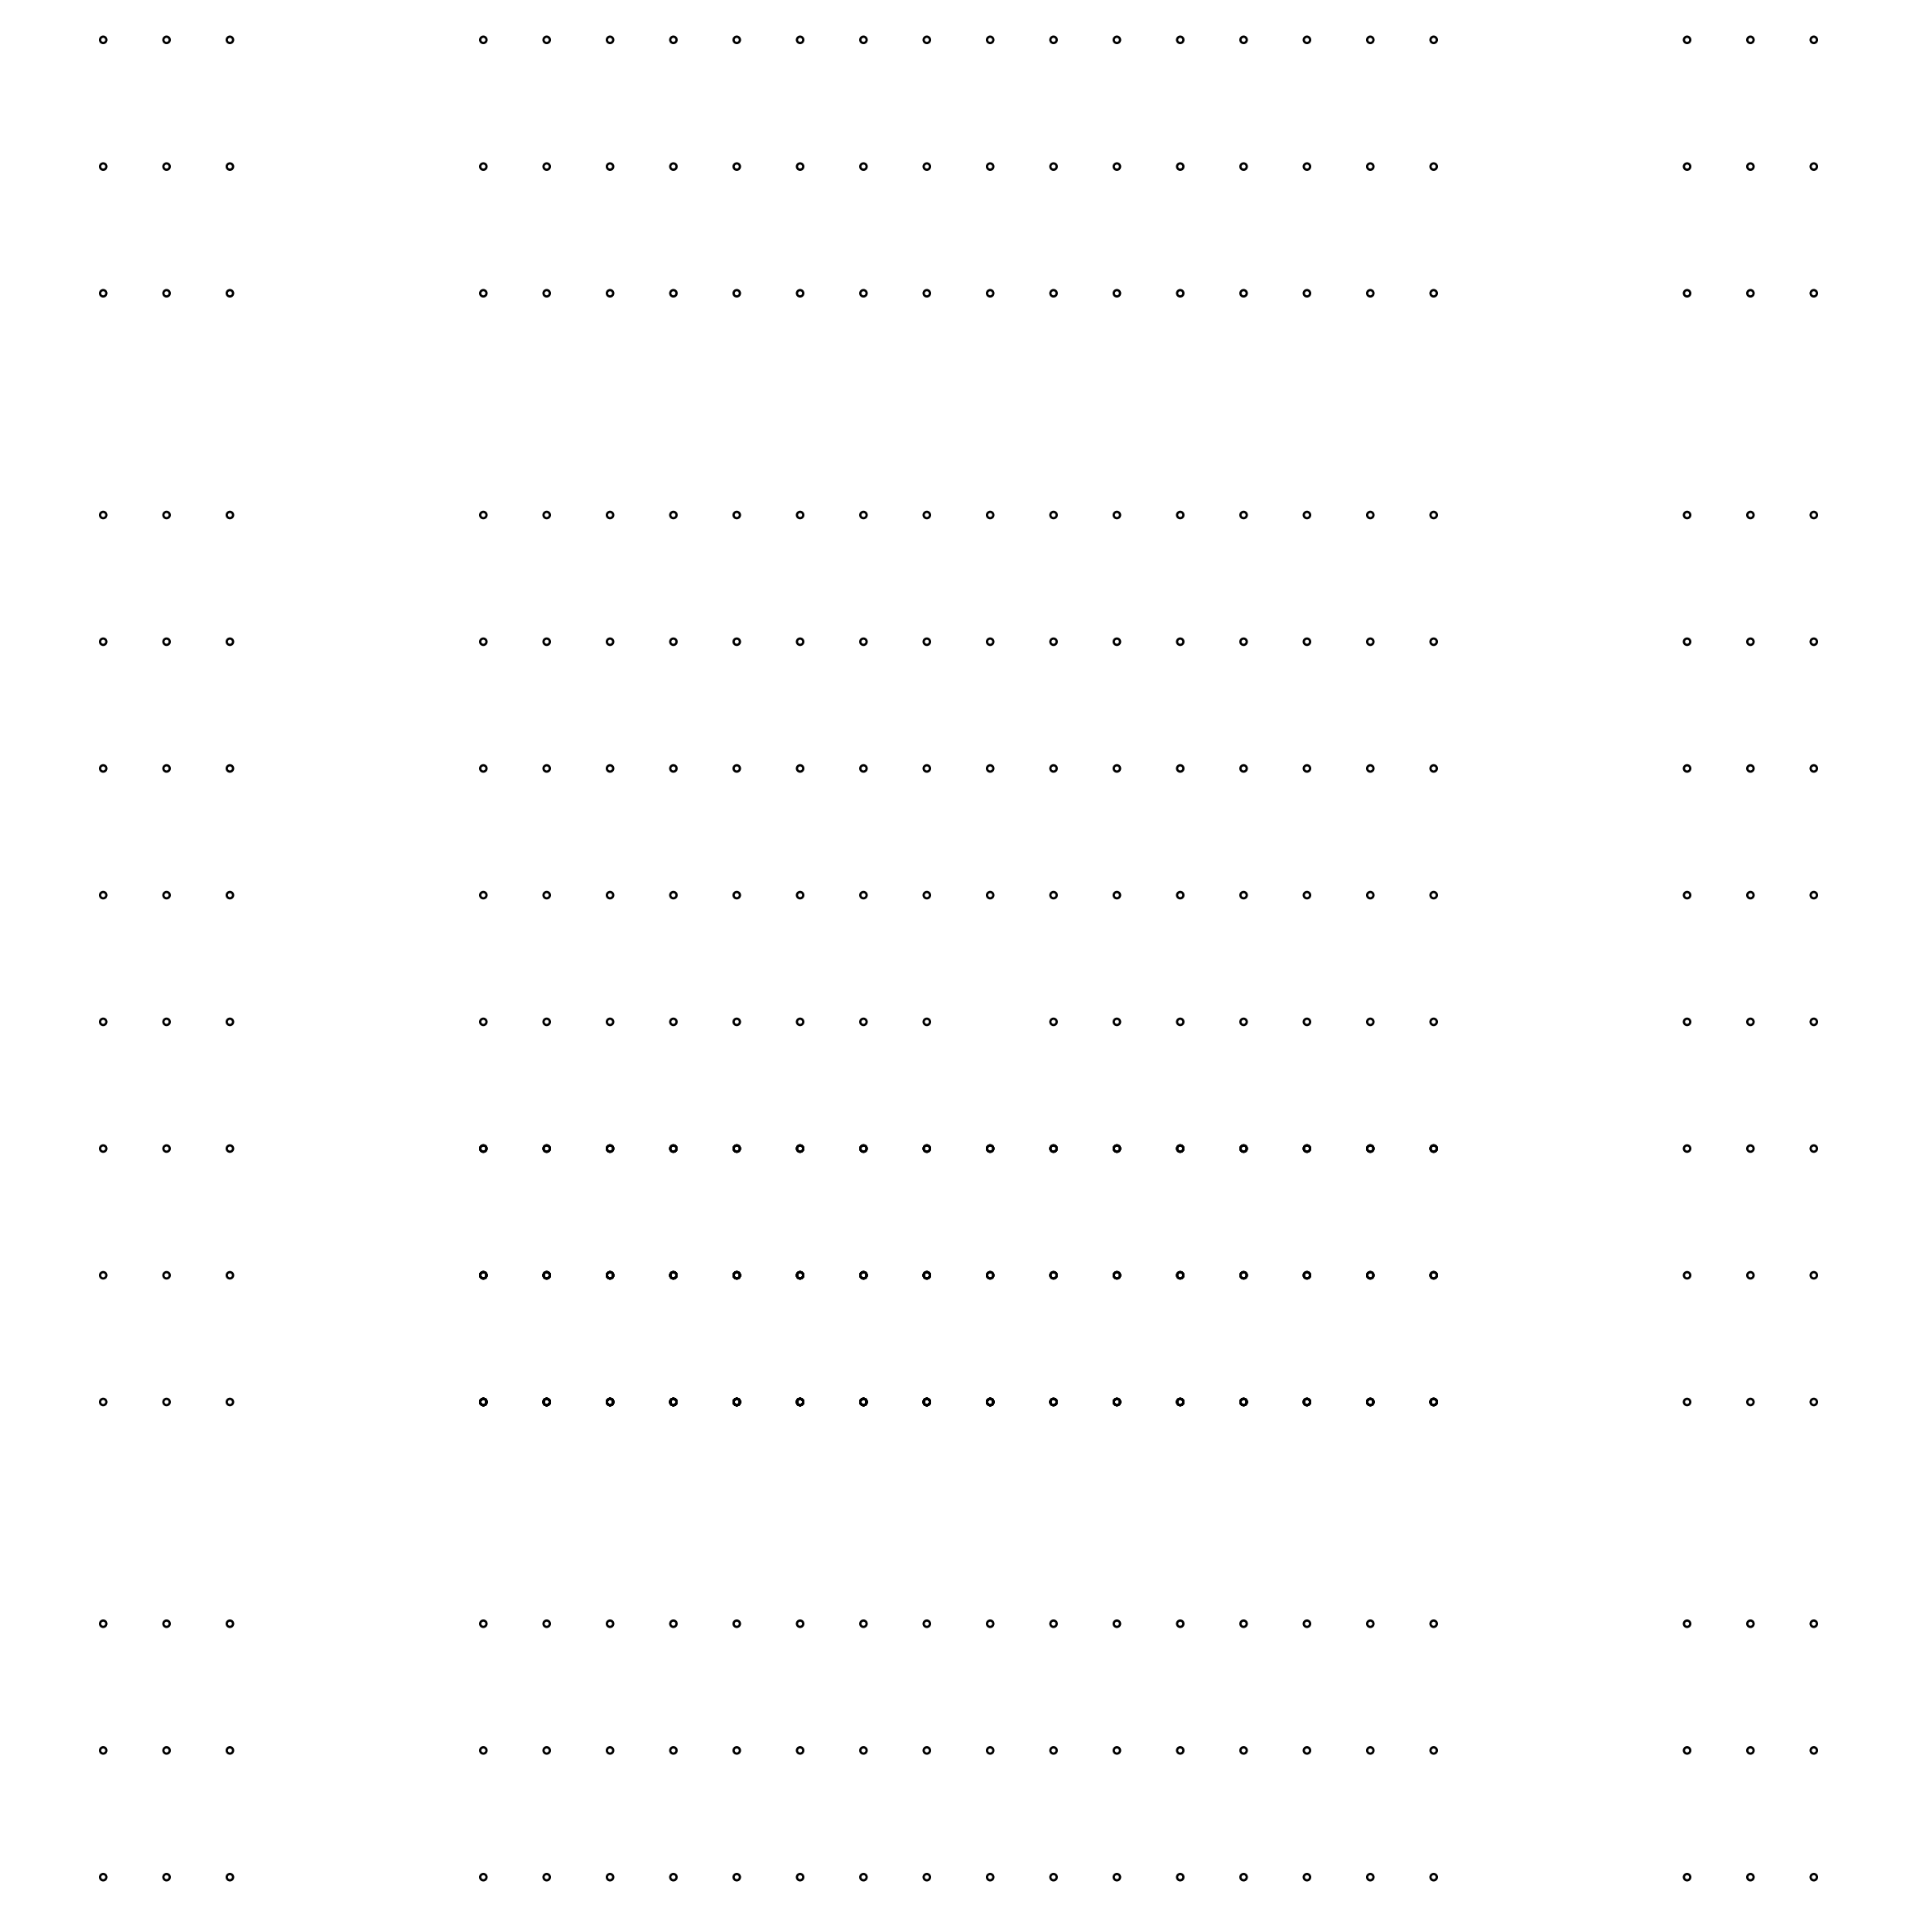
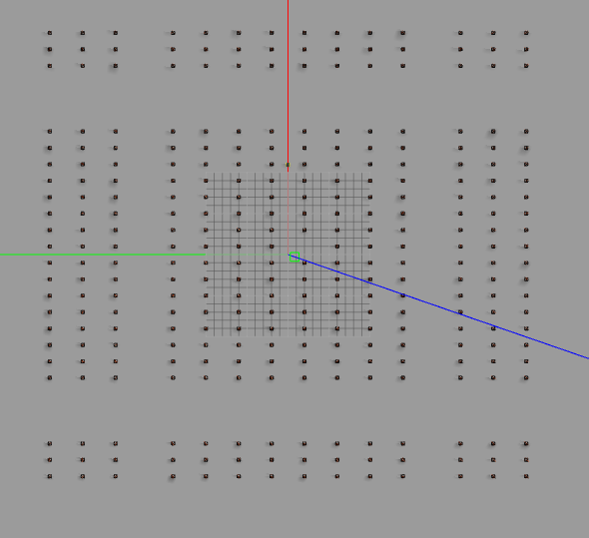
Experiment #1 : single cone missing
Wold name: cone_orcahrd5d
World Description: single cone missing, near the origin.
Special notes: 12,000 particles (max).
Experiment motivation: Checking whether a negative landmark (i.e.- an absence of cones) shall lead the AMCL algorithm to a valid localization solution.

Slide 12
Experiment #1 : single cone missing
Results: 7 successive simulations- 0/7(0%) success rate . I stopped there.
Example success graph:-N.A
Note: I simulated with larger/smaller number of particles. None succeeded.

Slide 13
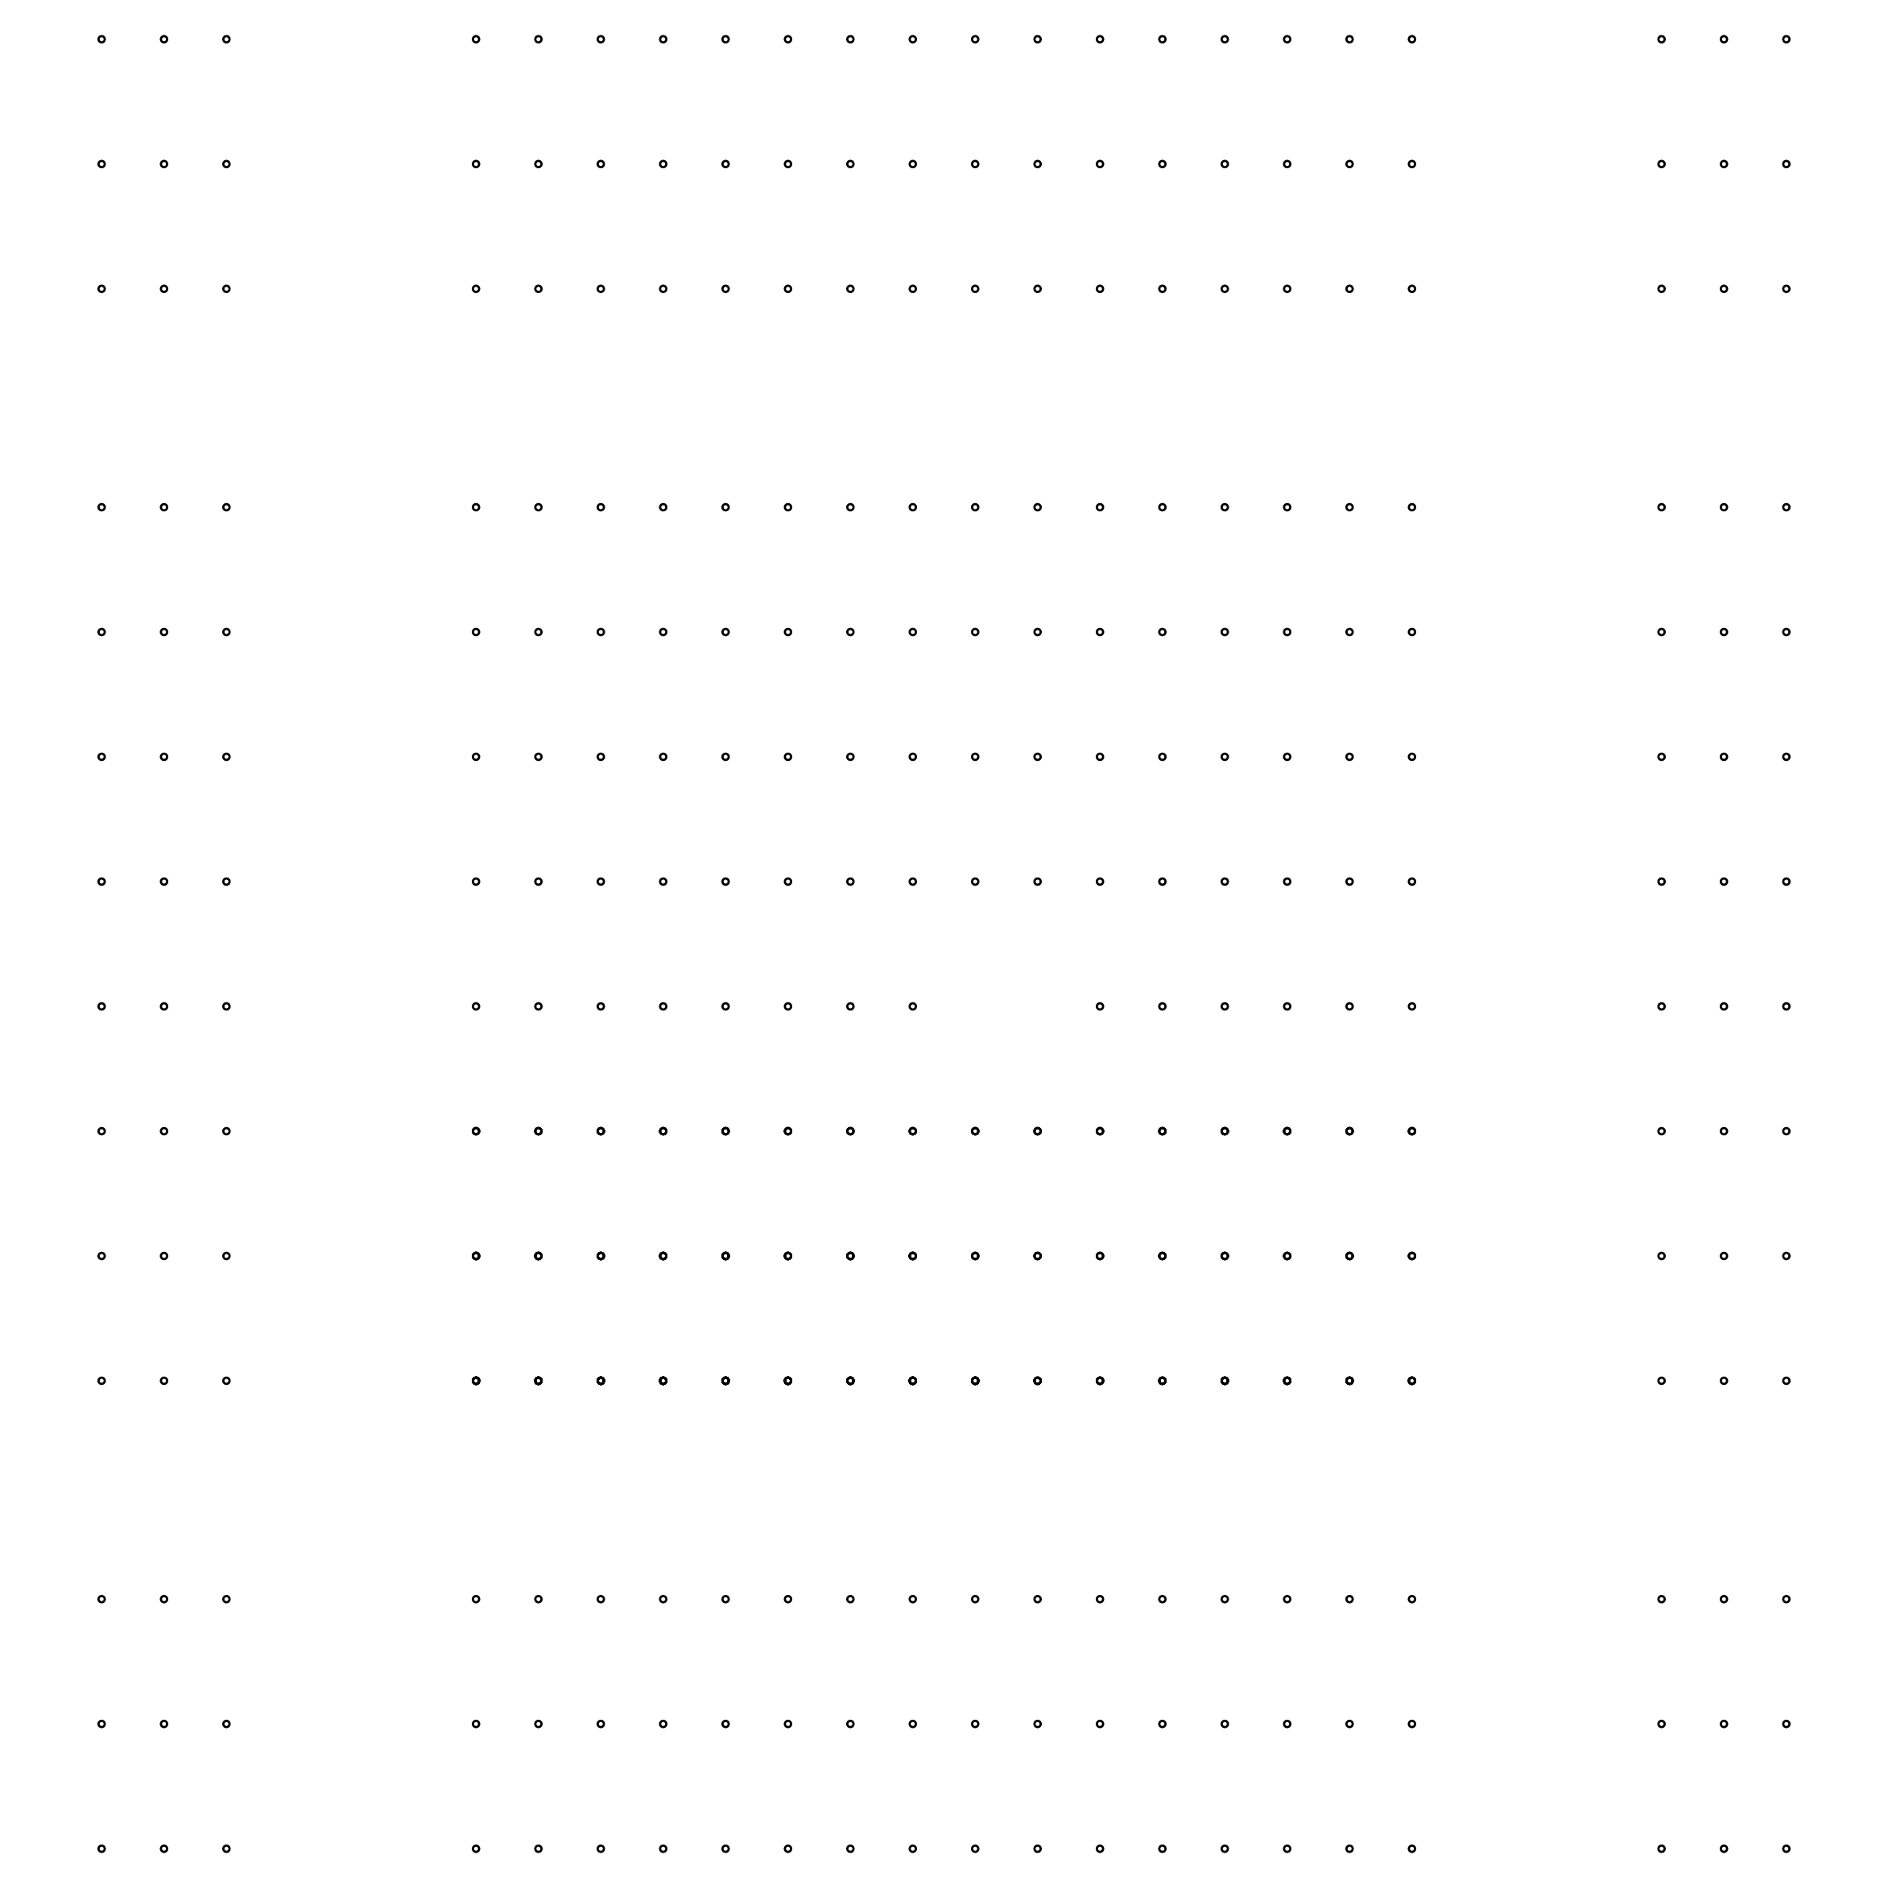
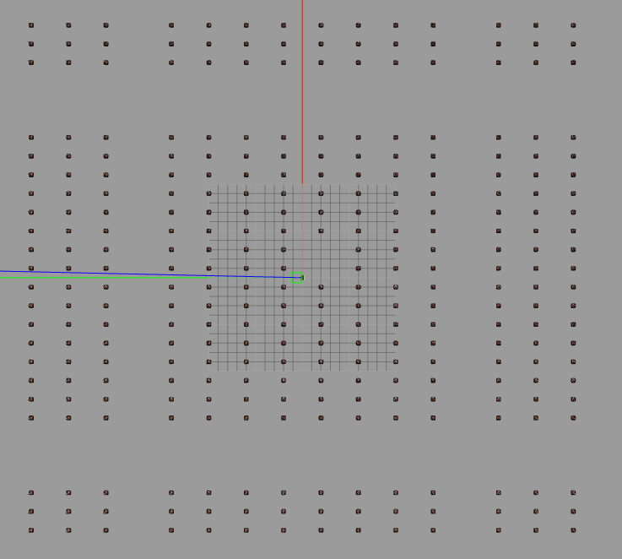
Experiment #2 : two cones missing
Wold name: cone_orcahrd5b
World Description: Two cones missing near the origin.
Special notes: 12,000-30000 particles (max).
Experiment motivation: Checking whether a negative landmark (i.e.- an absence of cones) shall lead the AMCL algorithm to a valid localization solution.

Slide 14
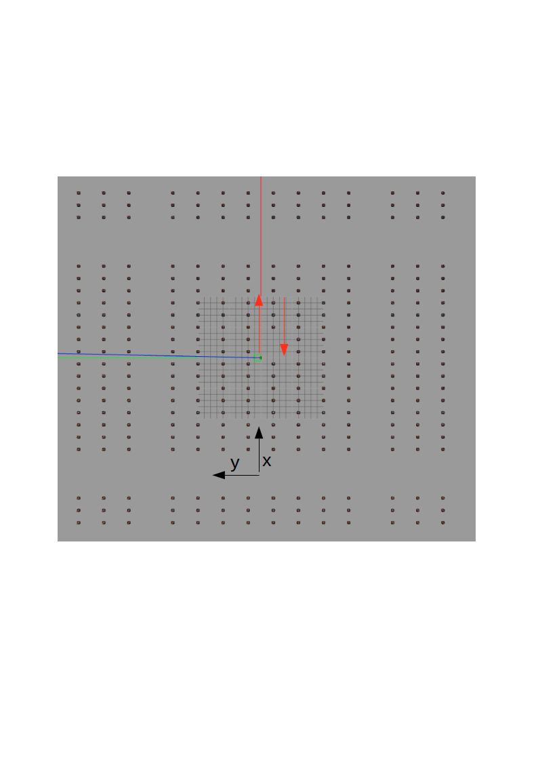
Experiment #2 : two cones missing
Special note: “Success” in this experiment is considered one of the two possibilities of the AMCL solutions-
  Locating the jackal in the row y=0 heading in the positive direction.
  Locating the jackal in the row y=-4 heading in the negative direction.
This is because both cases might look the same form the Jackal’s point of view having only laser scan and the map. The x coordinate must be correct in order to count a “success”.

Slide 15
Experiment #2 : two cones missing
Results: 22 successive simulations- 0/22 (0%) success rate.
Example success graph-None:

Slide 16
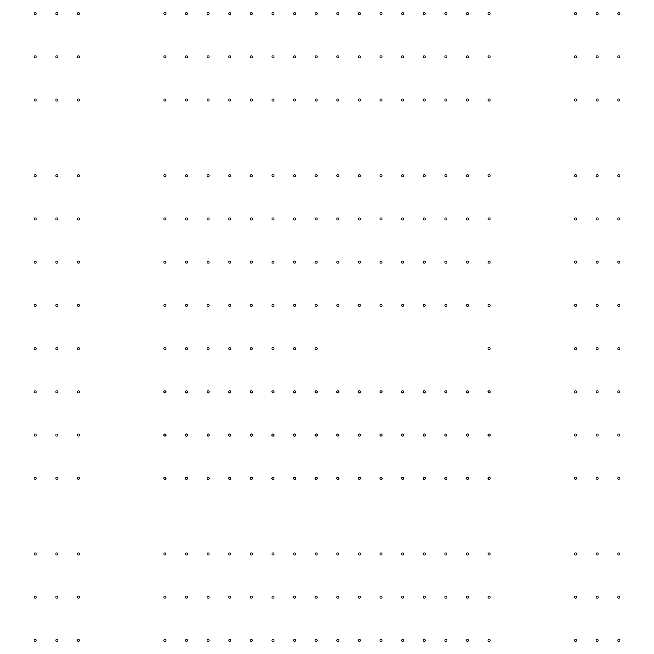
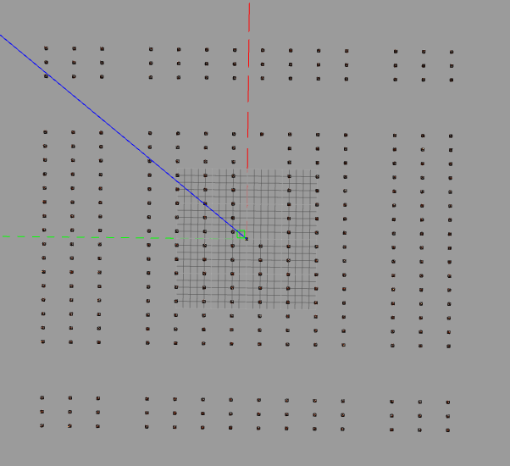
Experiment #3 : half row missing
Wold name: cone_orcahrd5c
World Description: (nearly) half a row of cones missing.
Special notes: 12,000 particles (max).
Experiment motivation: Checking whether a negative landmark (i.e.- an absence of cones) shall lead the AMCL algorithm to a valid localization solution.

Slide 17
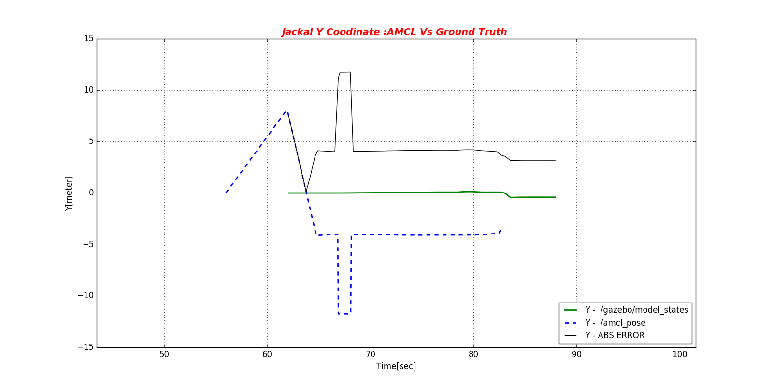
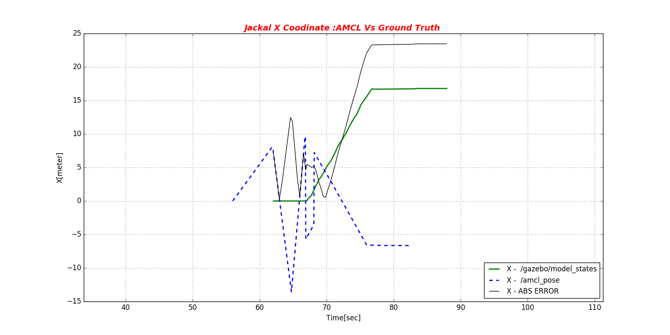
Experiment #3 : half row missing
Results: 10 successive simulations- 6/10 (60%) success rate .
Note : This is a single-axis problem. Again, from symmetry, a negative X-direction velocity and Y=-4 and not 0, is also considered valid, no matters the X.
Example success graph:

Slide 18
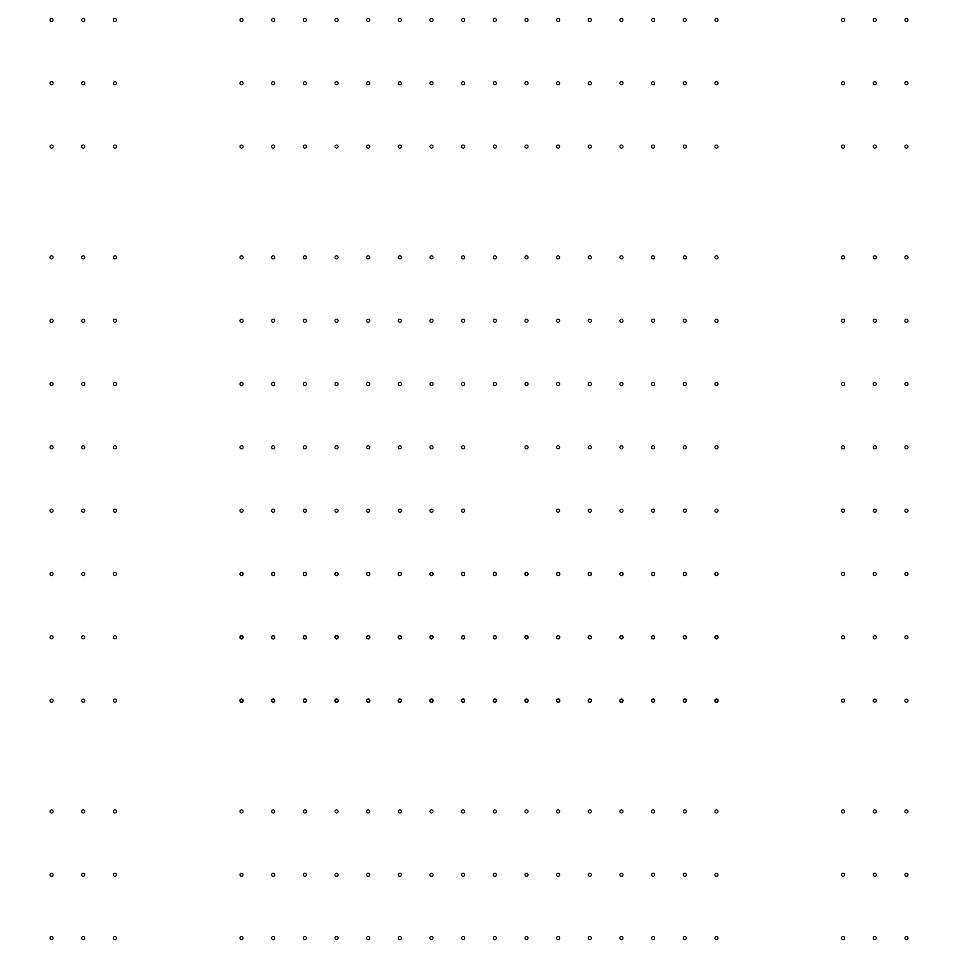
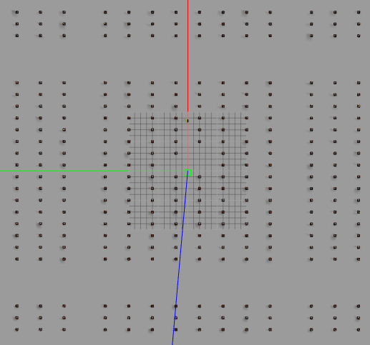
Experiment #4 : 3 cones missing both sides
Wold name: cone_orcahrd5e
World Description: 3 cones missing near the origin, on both sides.
Special notes:. various number of particles tested .
Experiment motivation: Checking whether a negative landmark (i.e.- an absence of cones) shall lead the AMCL algorithm to a valid localization solution.

Slide 19
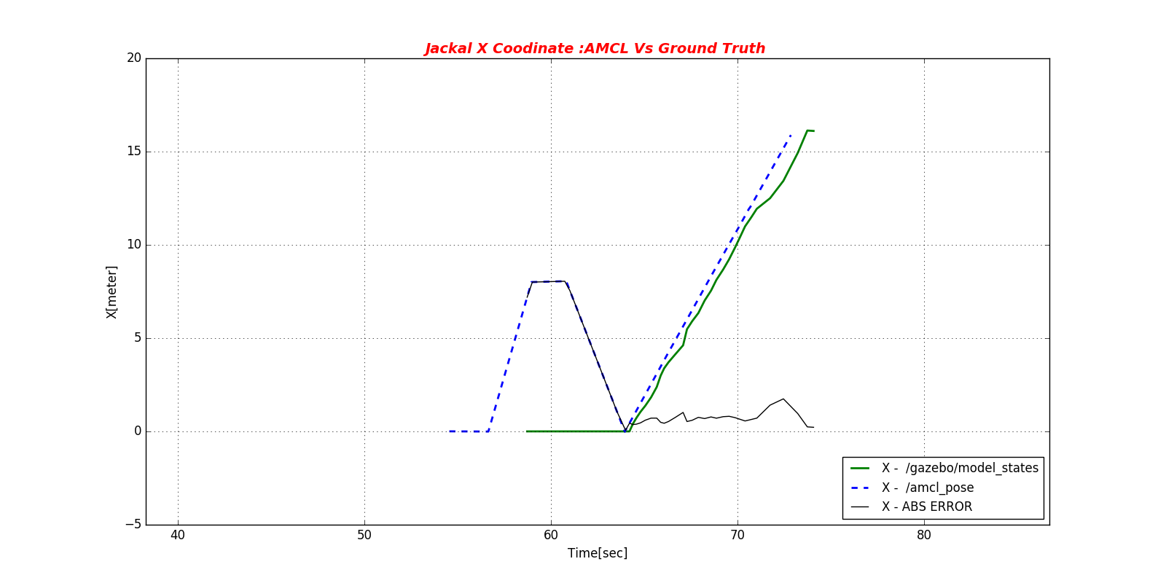
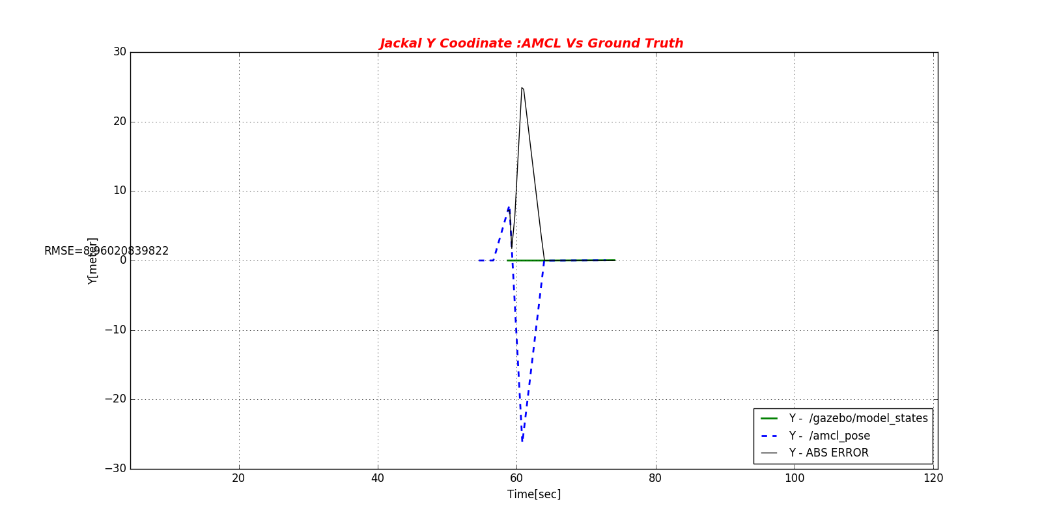
Experiment #4 : 3 cones missing both sides
Success rate- 4/6 with 18000 particles. Other numbers failed (30,000/12000) .
The algorithm located the robot correctly in both axis.
Example success graph:

Slide 20
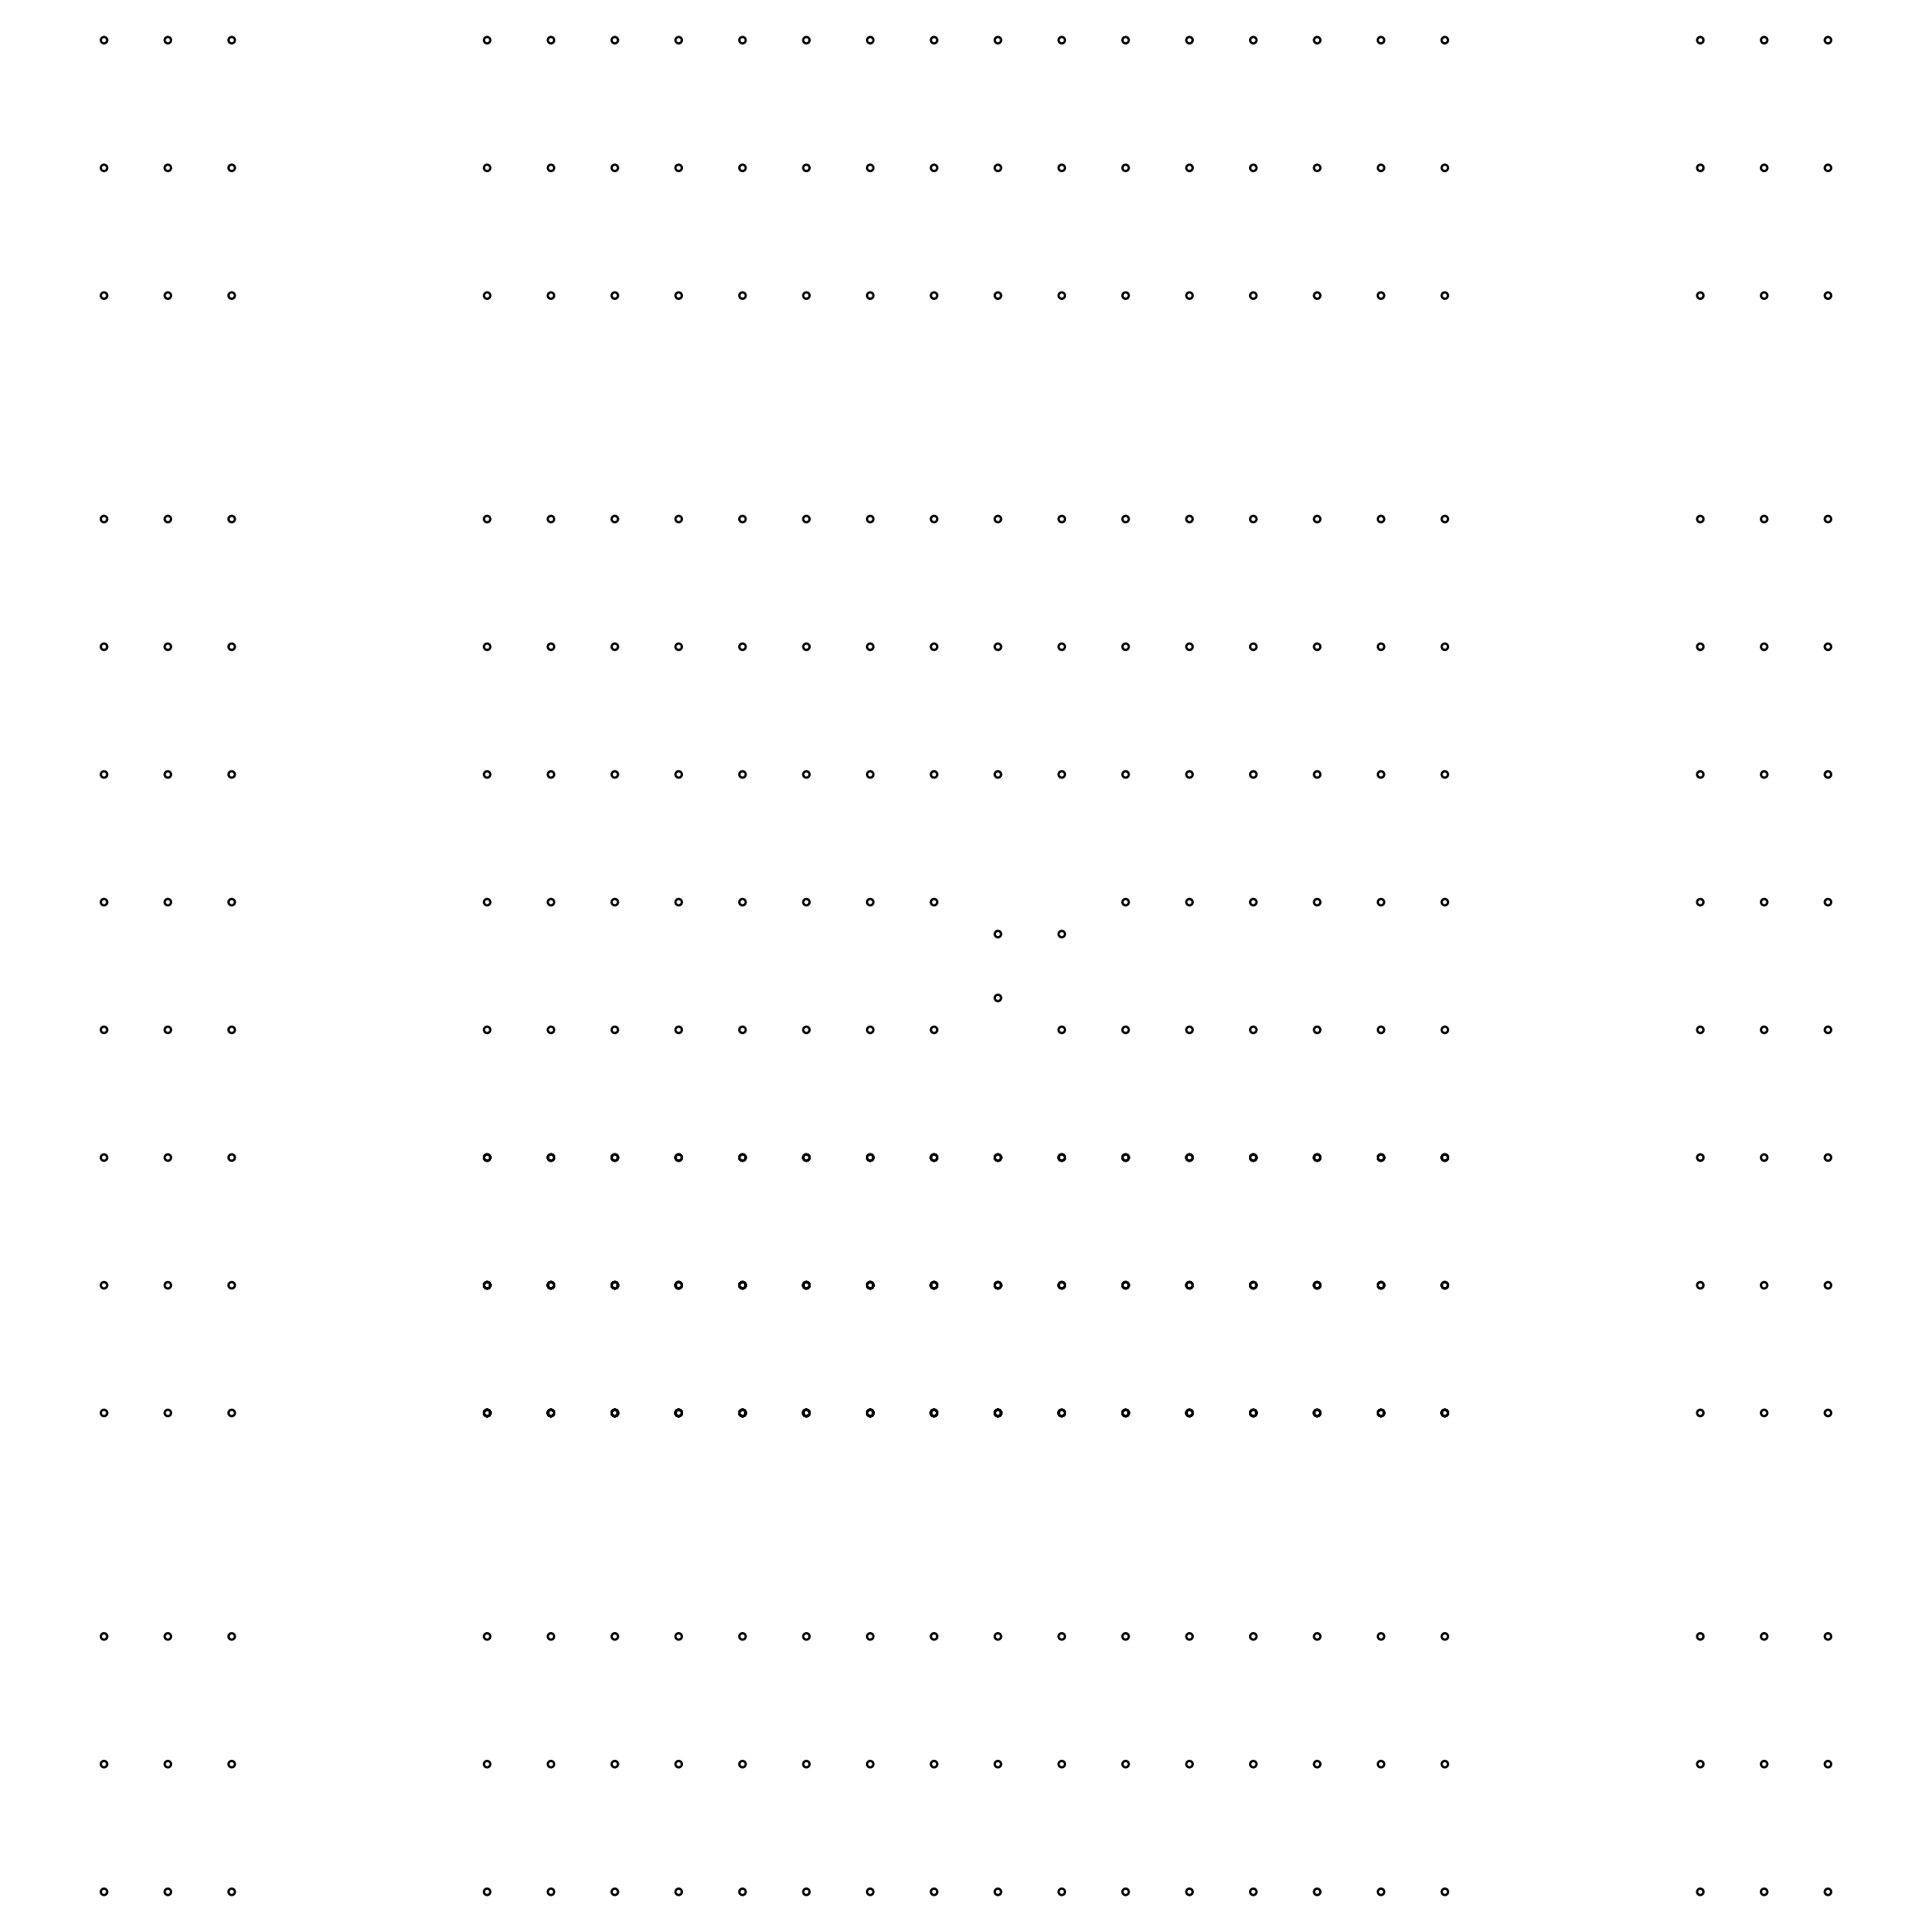
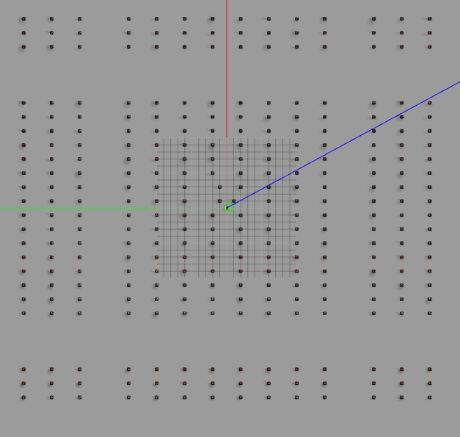
Experiment #5 : 3 cones out of line both sides
Wold name: cone_orcahrd6e/6f/6g (several constellations tested)
World Description: 3 cones are 1m ahead, on both sides near the origin.
Special notes: Various number of particles tested .
Experiment motivation: Checking whether an out-of order positive landmark (3 cones) shall lead the AMCL algorithm to a valid localization solution.

Slide 21
Experiment #5 : 3 cones out of line both sides
Results: 19 successive simulations- 0/19(0%) success rate . I stopped there.
Example success graph:-N.A
Experiments within the interval of 8000-30000 particles were made.

Slide 22
Conclusions and insights-experiments 1-4
The number of particles is a key characteristic of the AMCL algorithm. The performance of the algorithm may be much worst than optimal unless this parameter is carefully chosen by the user.
As a rule of thumb – the more the merrier. If the number of particles is too low the algorithm obviously yields poor localizations results since the sampling of the map does not cover it in enough detail/resolution.
Taking a too high parameter may lead to a heavy load on the hardware resources (CPU usage, memory) , a very long convergence time . If the landmark is visible for a relatively short time while the convergence time is very long, By the time the algorithm re-sampling process gets to its final steps, the landmark has already become invisible to the sensors a long time before (“obsolete”), and might be ignored. Experiment 4 failed with 30,000 particles but succeeded with 18,000.
The best thing to do is to scale this parameter on a given world (running several trials) in order to get better results. Maybe there is a method for optimizing the number of particles to a given map, but I am not aware of such method. The default number in the navigation stack (2000) was very far form those I found to work best.
One must mention that the user must initiate the global localization service himself. I would expect a good localization algorithm to invoke a “global search” automatically, especially in cases where the map does not fit the measurements for a long (predefined) period of time.

Slide 23
Conclusions and insights-experiments 1-5
Surprisingly, negative landmarks are not good enough . Having the map and measurements, “The reasonable human being” would have solve the localization problem easily. I would expect that a few missing cones in a small area shall lead the AMCL to a valid localization solution, but this is not the case.
Surprisingly, 3 cones out of place on both sides were not enough. I don’t have a good explanation for that besides determining that the algorithm is rather “spoiled”. Experiment 5 yielded 0% success.

Slide 24
Conclusions and insights-experiments 1-5
Surprisingly, negative landmarks are not good enough . Having the map and measurements, “The reasonable human being” would have solve the localization problem easily. I would expect that a few missing cones in a small area shall lead the AMCL to a valid localization solution, but this is not the case.
Surprisingly, 3 cones out of place on both sides were not enough. I don’t have a good explanation for that besides determining that the algorithm is rather “spoiled”. Experiment 5 yielded 0% success.

Slide 25
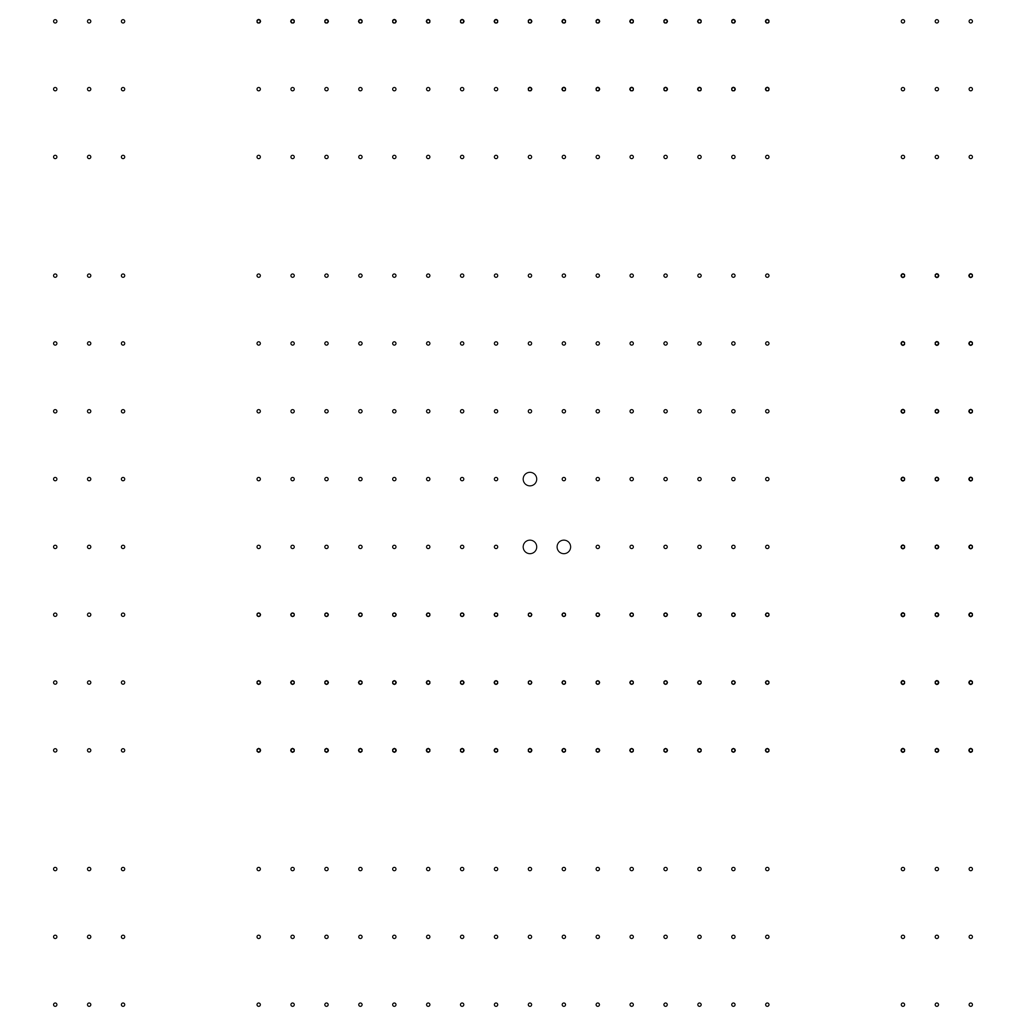
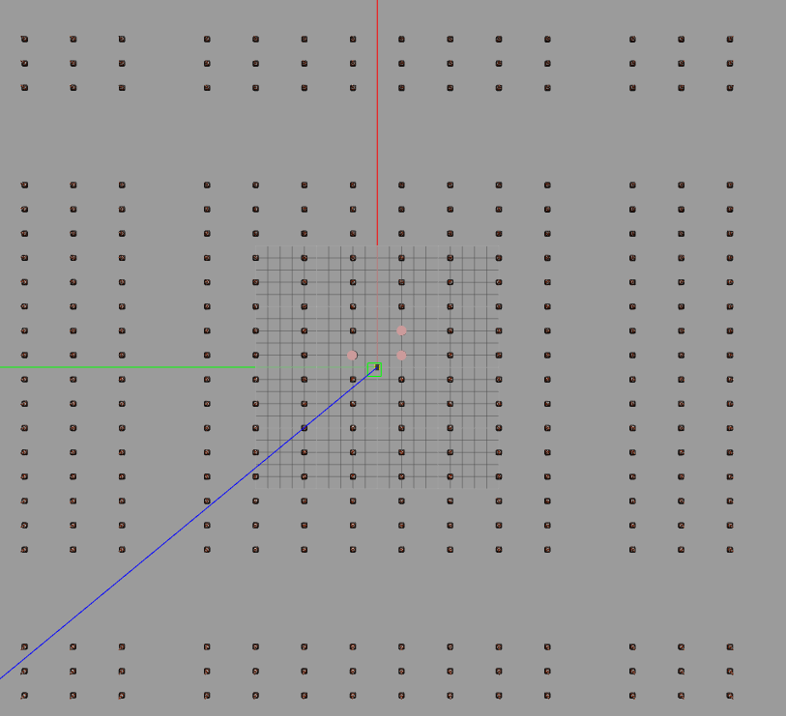
Experiment #6 : 3 large cylinders both sides
Wold name: cone_orcahrd6d
World Description: 3 cylinders with radius=0.4m near the origin.
Special notes: various number of particles tested .
Experiment motivation: Checking whether distinguishable positive landmark (3 large cylinders) shall lead the AMCL algorithm to a valid localization solution.

Slide 26
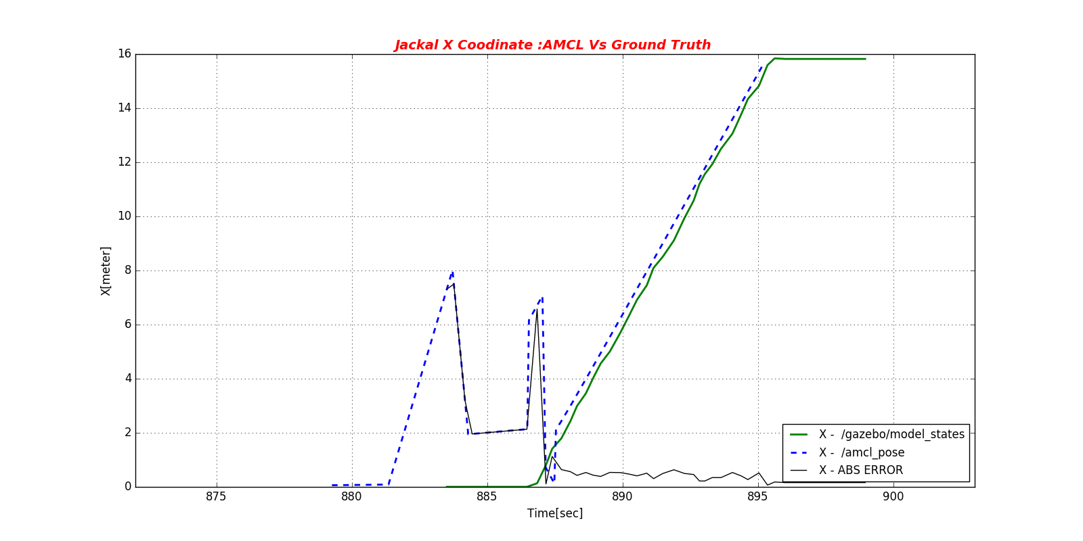
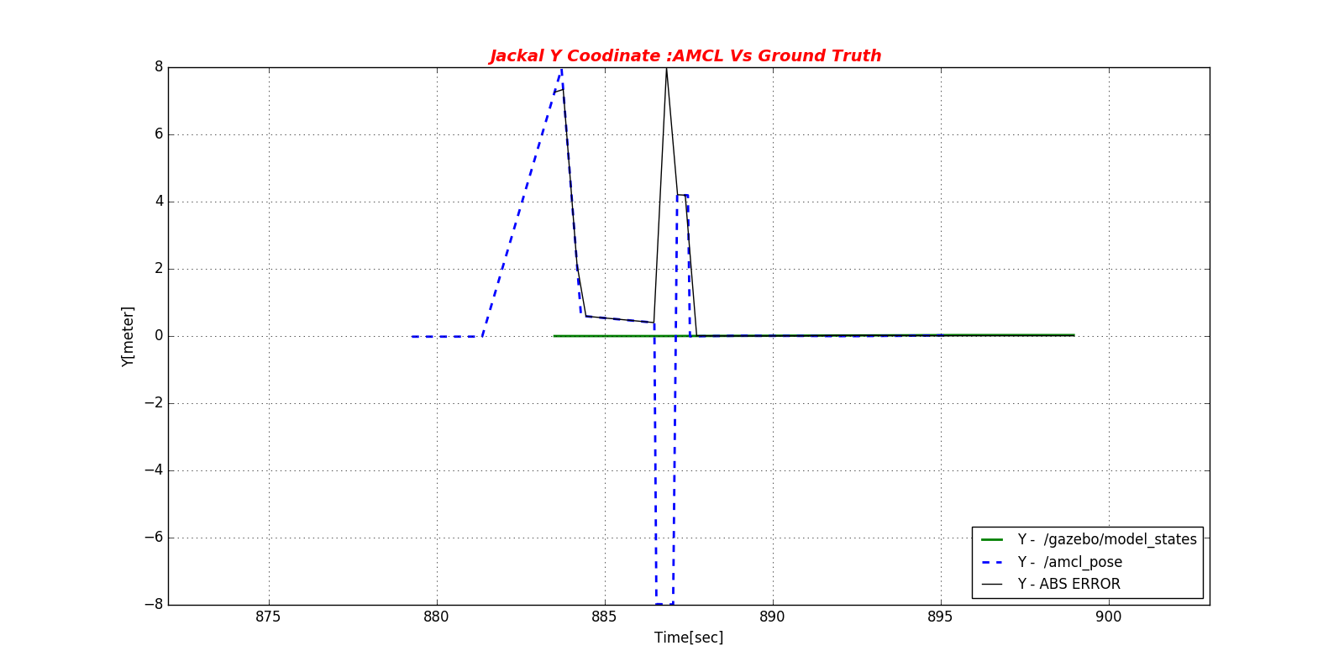
Experiment #6 : 3 large cylinders both sides
Results: 5 successive simulations- 5/5 (100%) success rate with 3000 particles.
20,000 particles-1/3 success (33%). Using less particles turned to be worse.
The algorithm located the robot correctly in both axis
Example success graph:

Slide 27
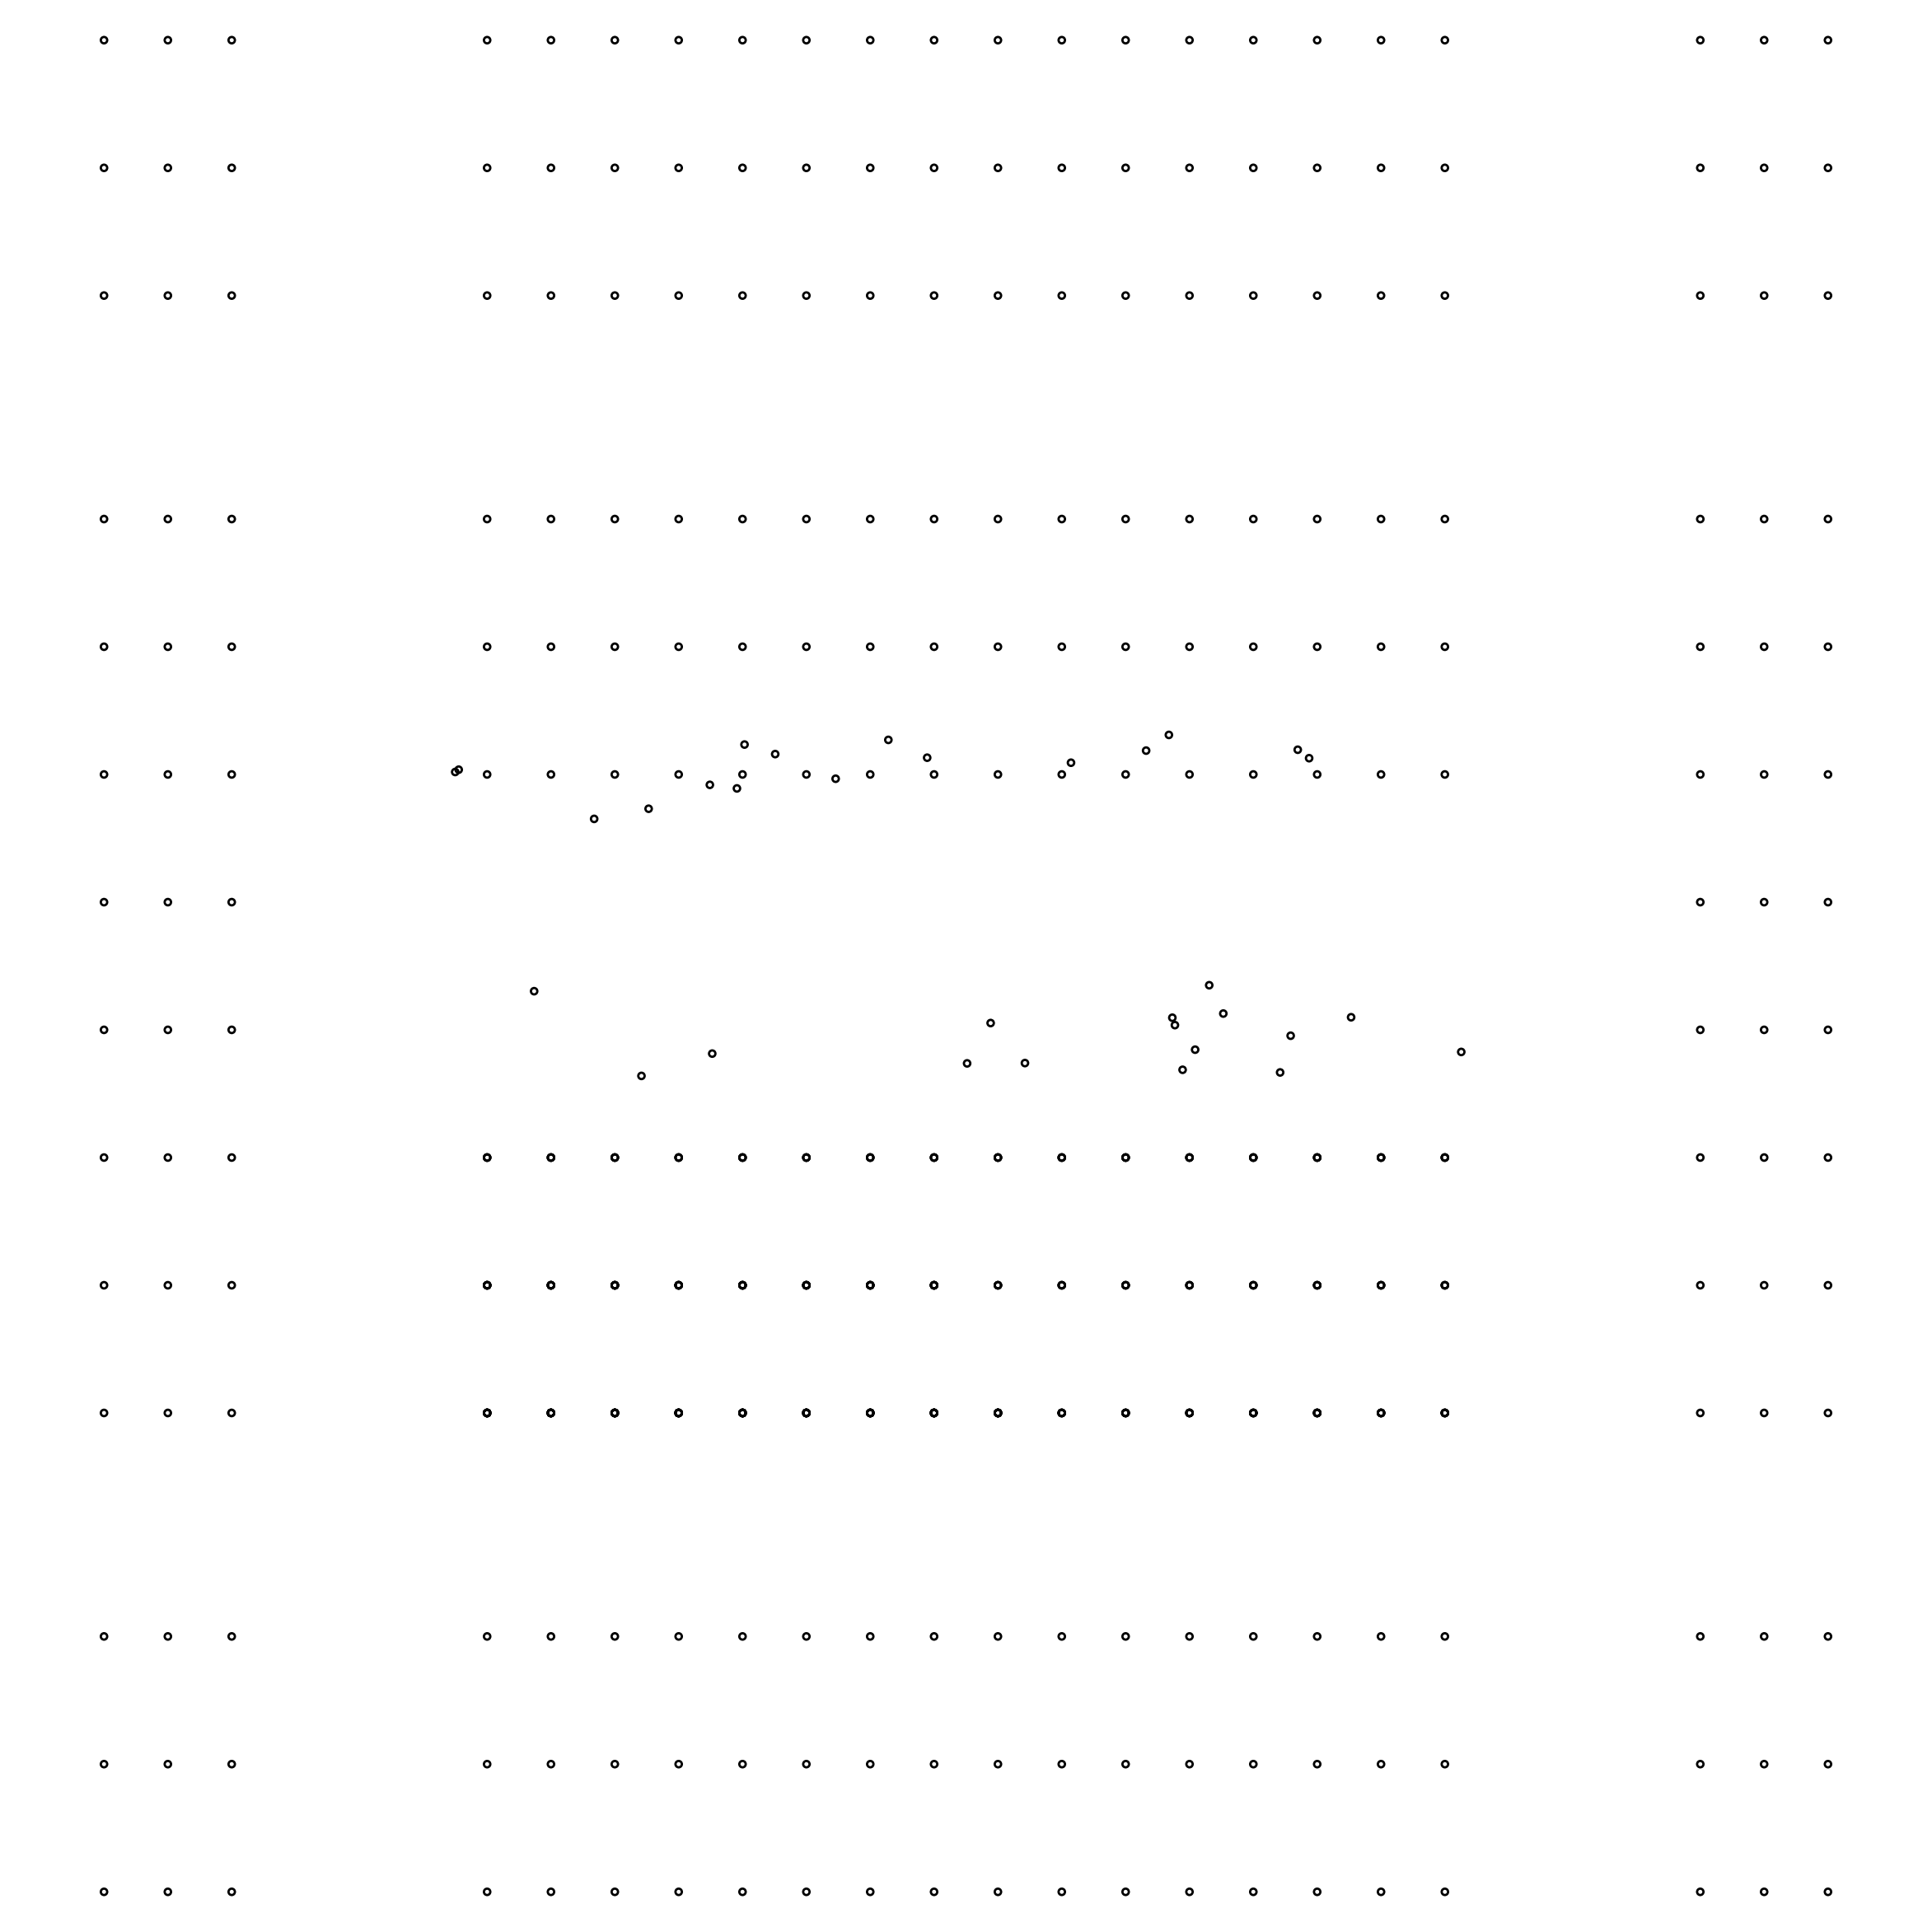
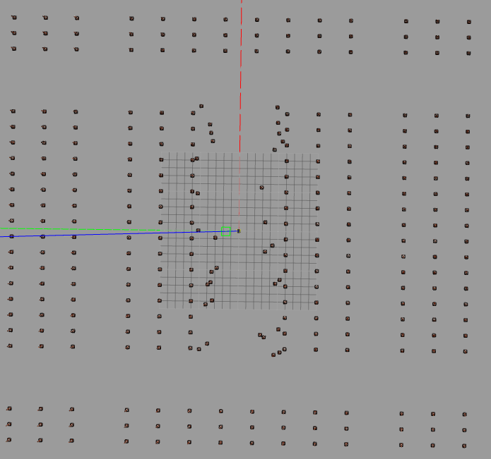
Experiment #7 : two random rows of cones
Wold name: cone_orcahrd7b
World Description: two row of cones ordered randomly on both sides of the origin
Special notes: 30000 particles tested .
Experiment motivation: Checking whether large disorder shall lead the AMCL algorithm to a valid localization solution.

Slide 28
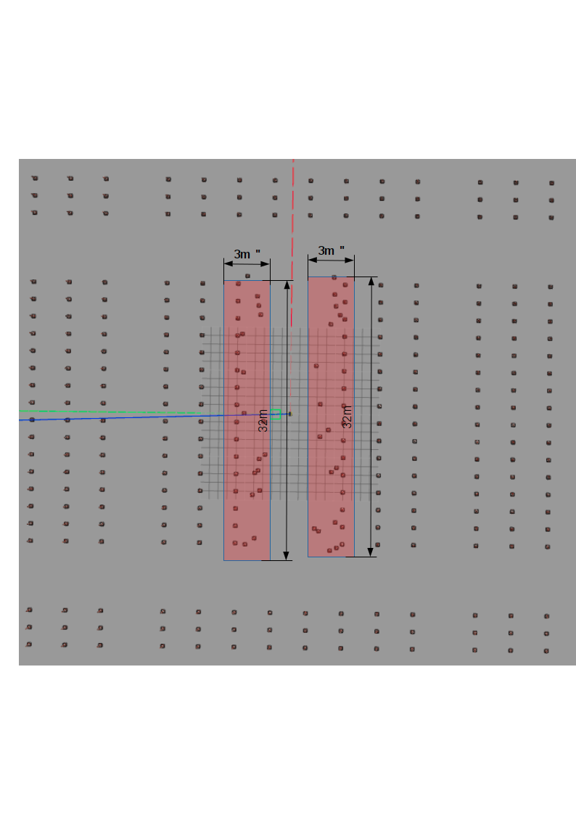
Experiment #7 : two random rows of cones
Wold name: cone_orcahrd7b
Special notes: The “random row” was created using gazebo 7 “population of models” feature. See http://gazebosim.org/tutorials?tut=model_population&cat=
As a result, each experiment has been carried out on a different world, using a different new map created for that experiment only.
The map was saved together with the results graphs.

Slide 29
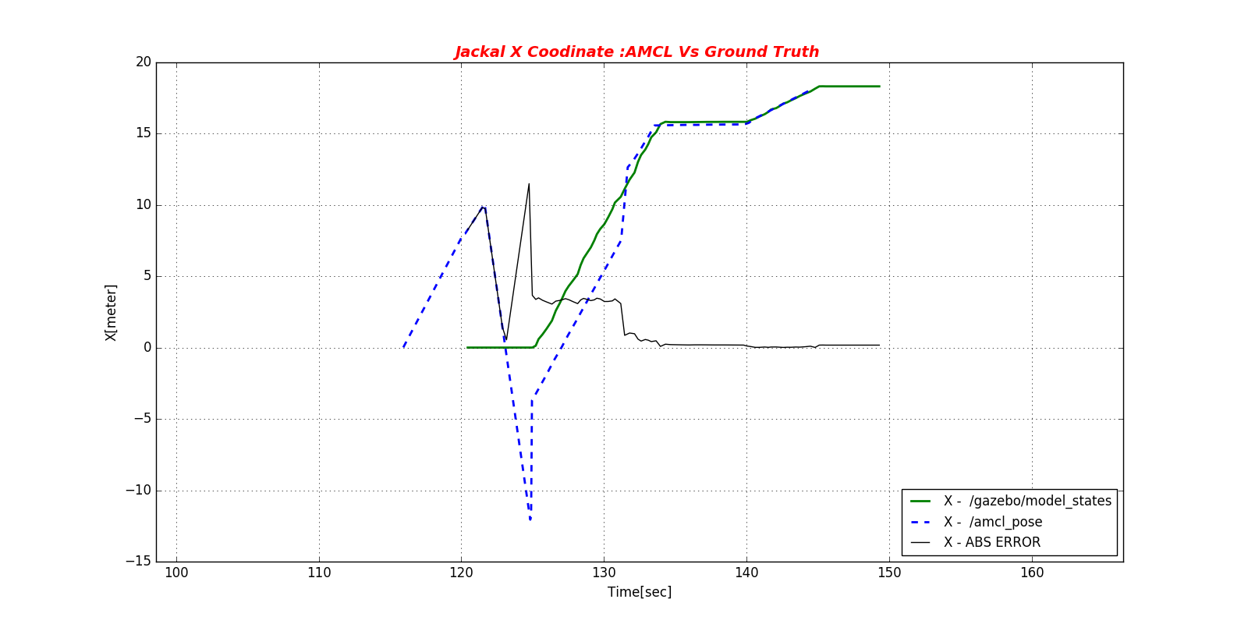
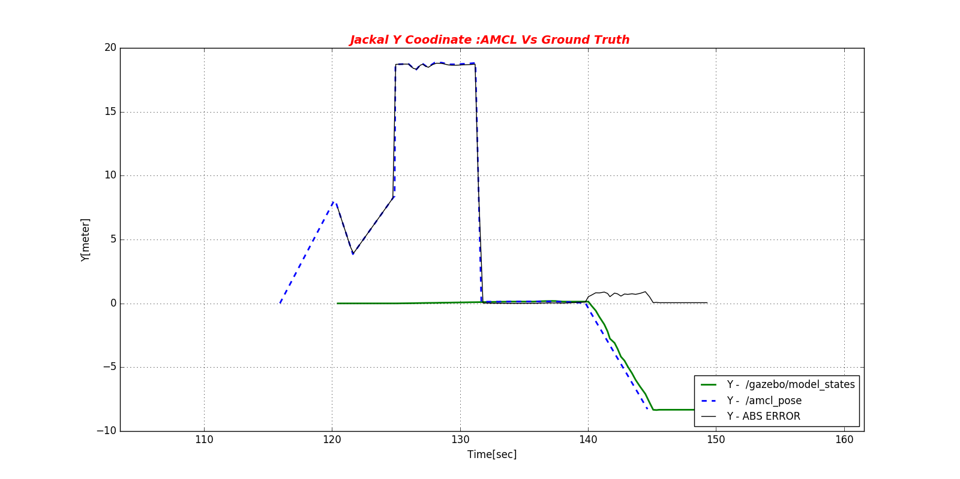
Experiment #7 : two random rows of cones
Results: 10 successive simulations- 8/10 (80%) success rate with 30000 particles.
The algorithm located the robot correctly in both axis
Example success graph:

Slide 30
Conclusions and insights-experiments 6-7
Distinguishable landmarks work. Large disorder also works. Experiments 6 and 7 are sort of “control” experiment. I wanted to see if taking very large landmarks or large disorder (both introduce quite large heterogeneity), shall lead to good localization results, and indeed- they did. Although these experiments do not reflect regular orchards, It was important to see if AMCL can work well at all.

Slide 31
World of Cylinders
World Description: In order to simulate better “real life” orchards, I created a world of cylinders instead of cones. The main difference between the two is that the structure of the gazebo’s “ready made” cone model cannot be changed. The Jackal’s laser scan sensor “cuts” a cross section of the cone which results in a circle with a diameter of 0.2m.
Special notes:
The trees were simulated using 5 models of cylinders :
    Nominal tree with a diameter of 0.28m
    +- 10 % of the nominal diameter (0.308m , 0.252m)
    +- 20 % of the nominal diameter (0.224m , 0.336m)
Each model was colored in a different color in gazebo, in order for me to distinguish between them easily. The colors of do not influence the ground truth map /laser scan in any way.
The allowed deviation in the location of each tree In the orchard is limited to
+-20 [Cm] in each coordinate.
Each cylinder was of course also modeled on the ground truth map.

Slide 32
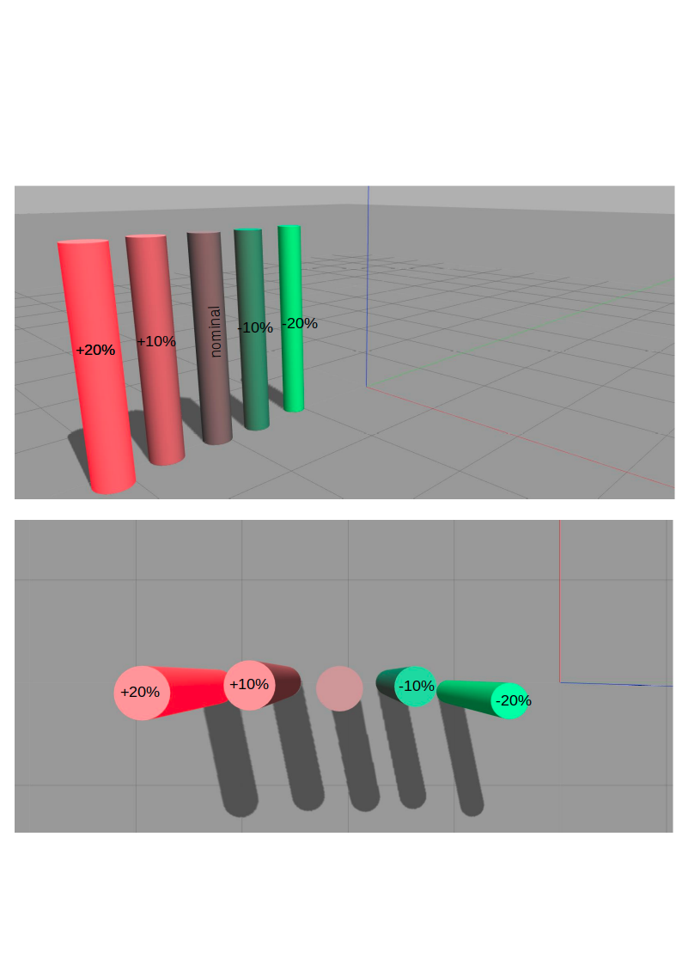
World of Cylinders
The cylinders models:

Slide 33
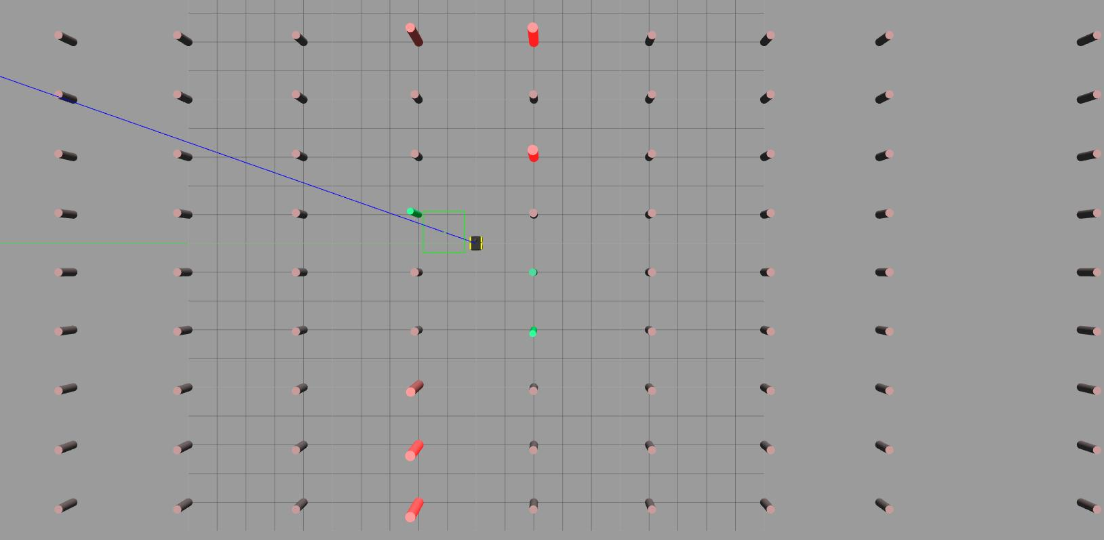
World of Cylinders
A world example:

Slide 34
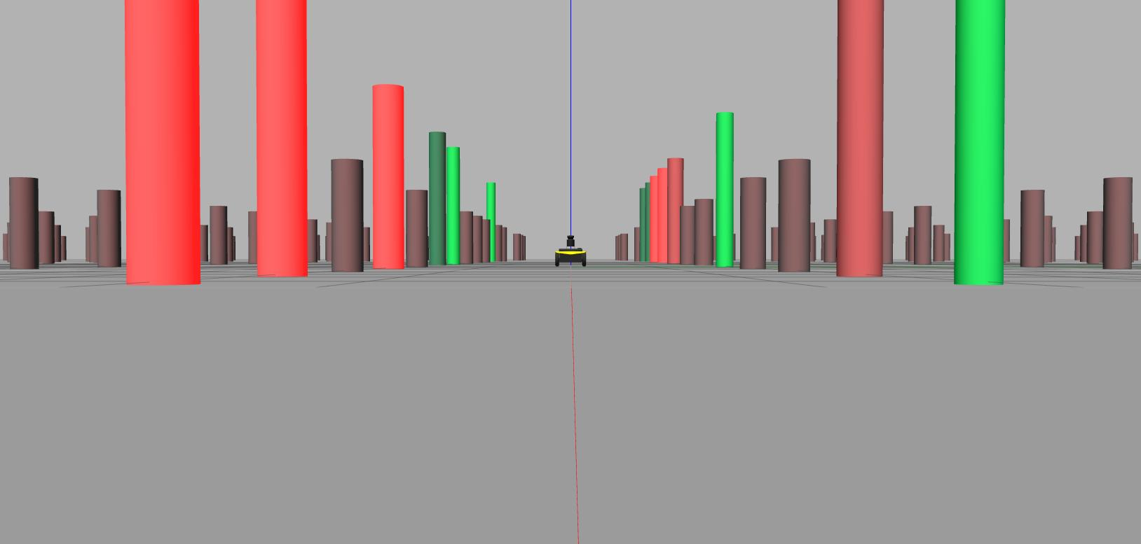
World of Cylinders
A world example. The height difference is a strange bug in gazebo, all models are at the same height and they all appear on the map and seen by the laser scan.

Slide 35
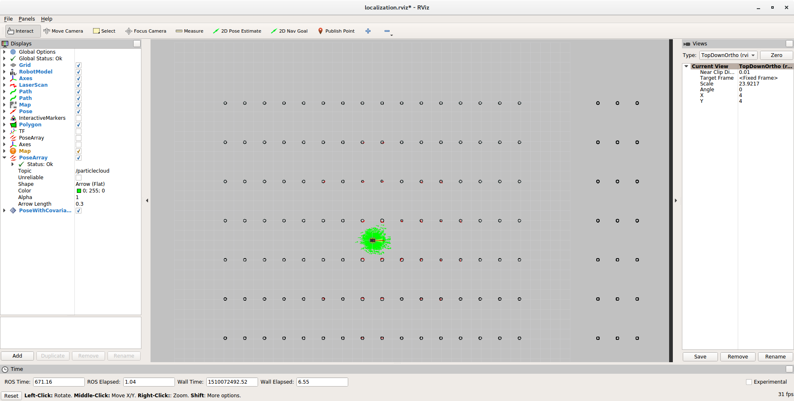
World of Cylinders
A Rviz window with map example. One can see the various diameters of the cylinders.

Slide 36
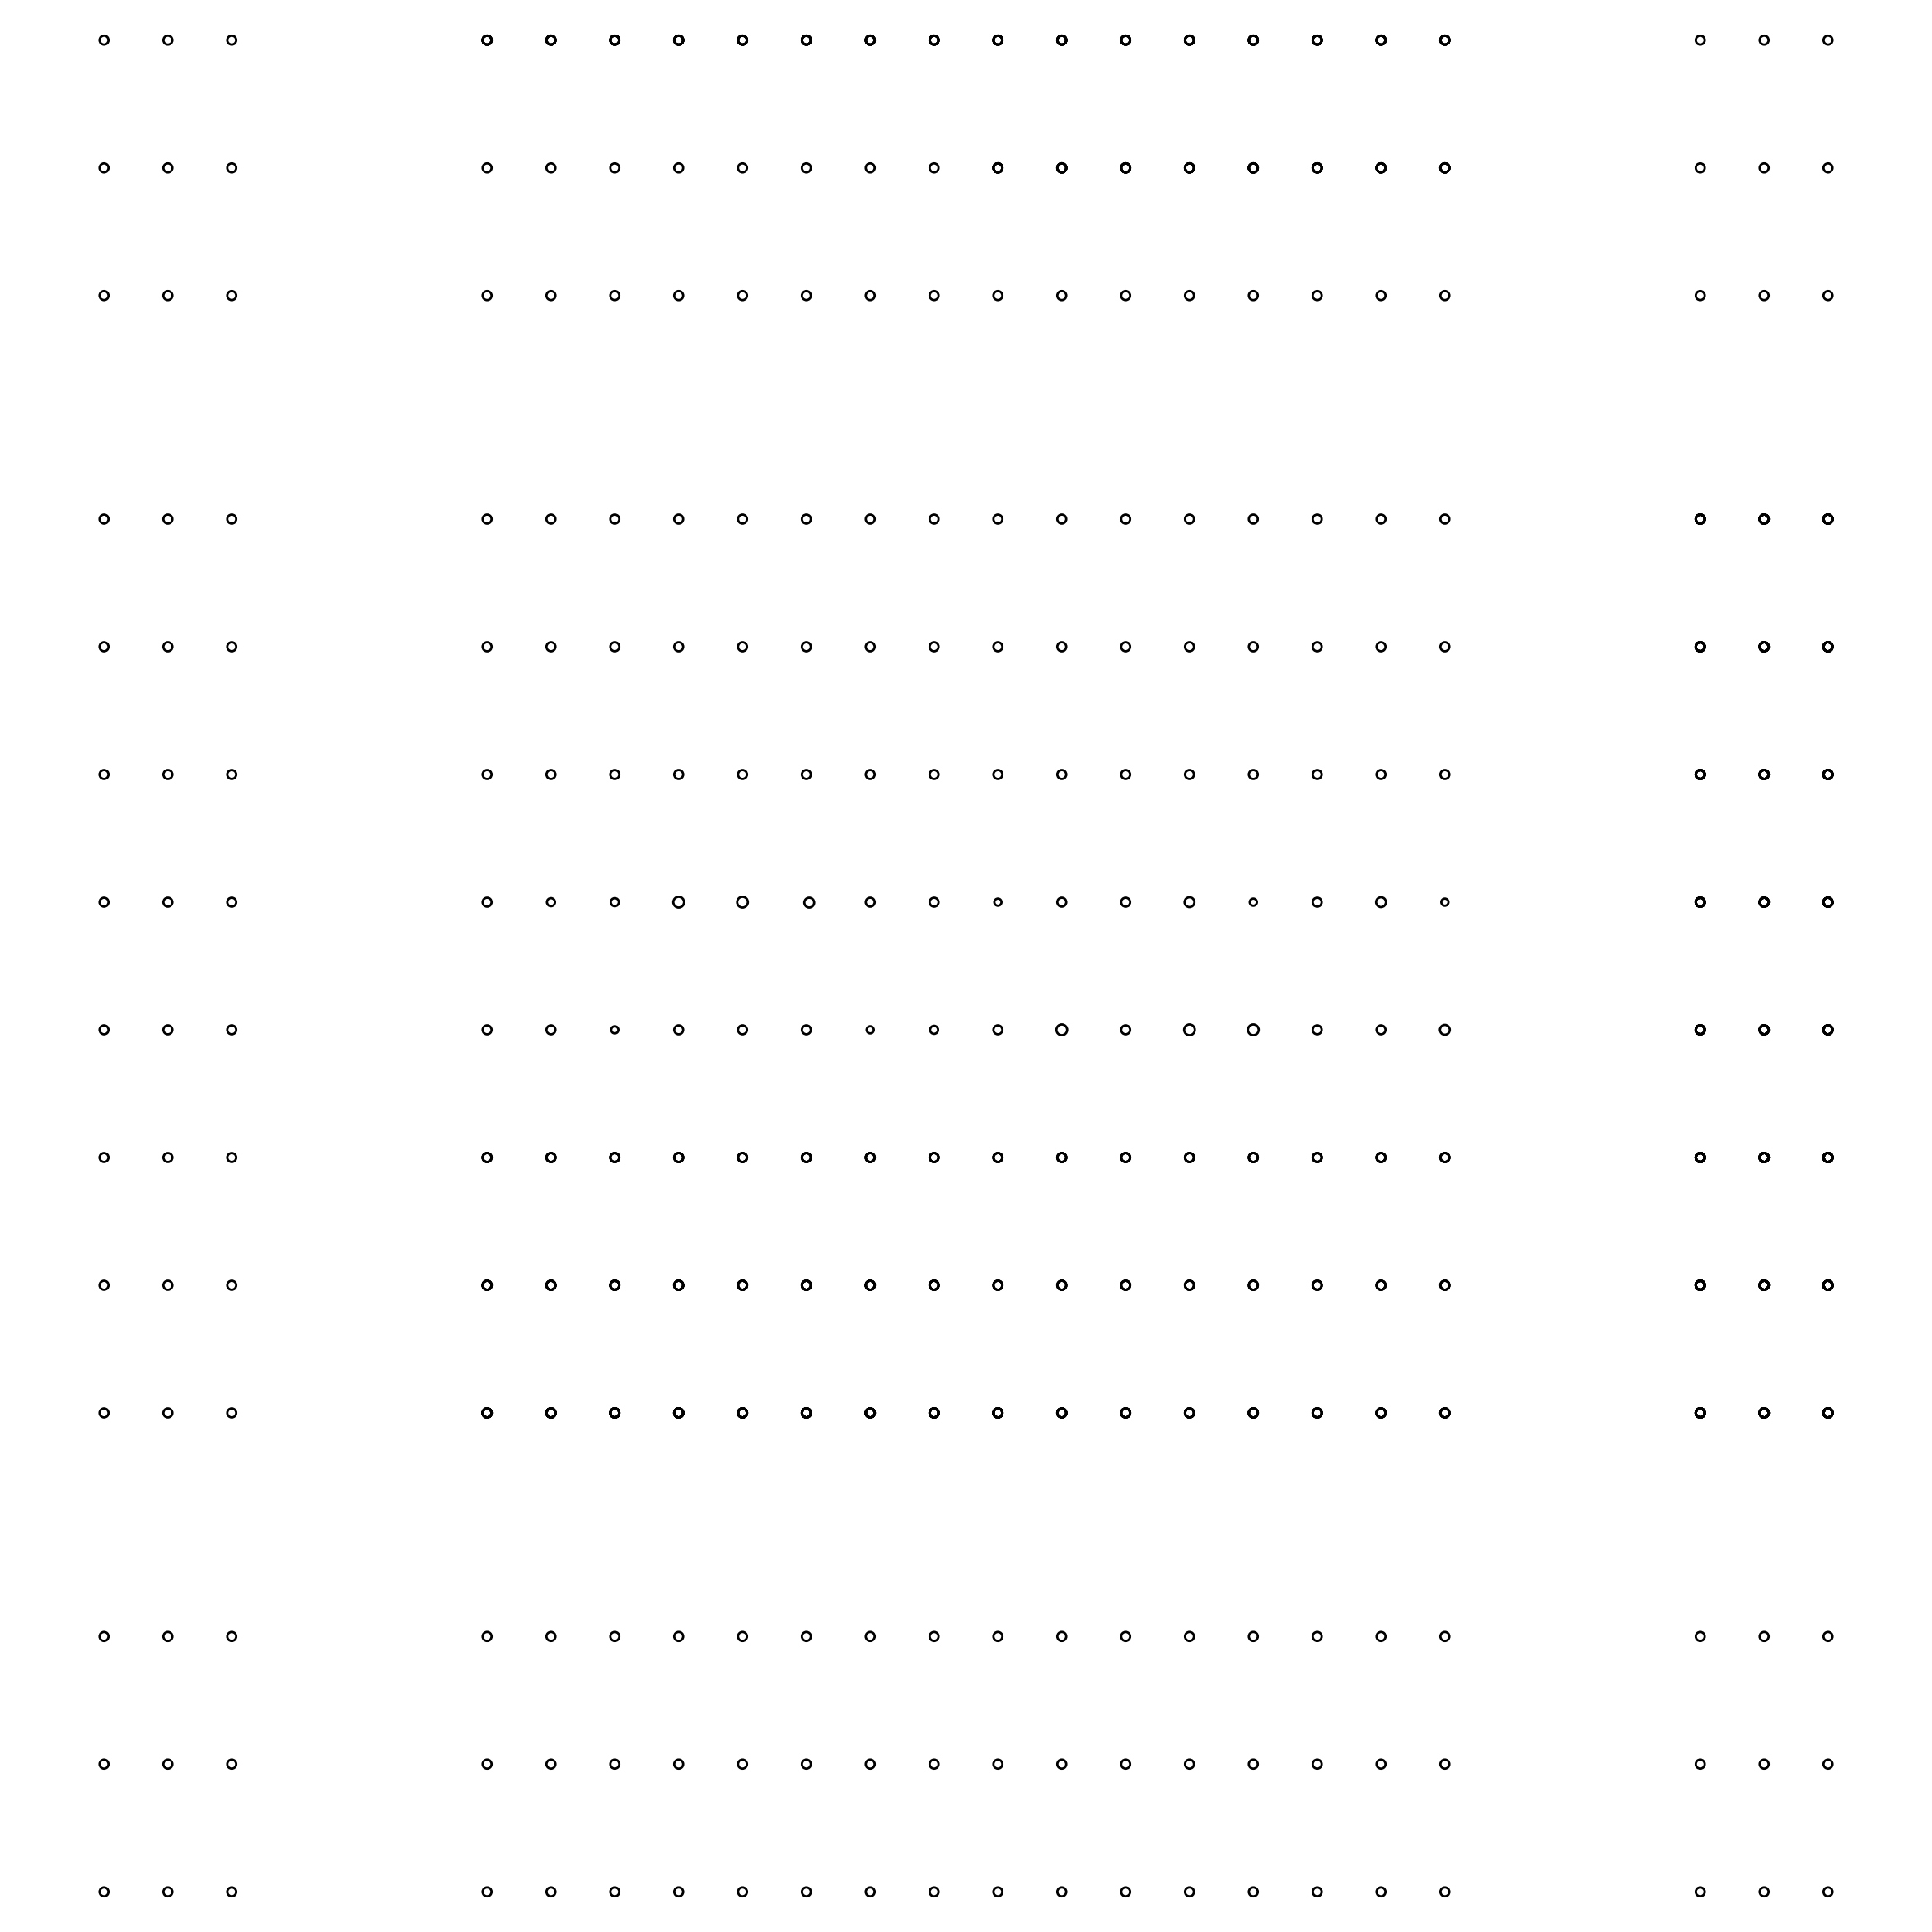
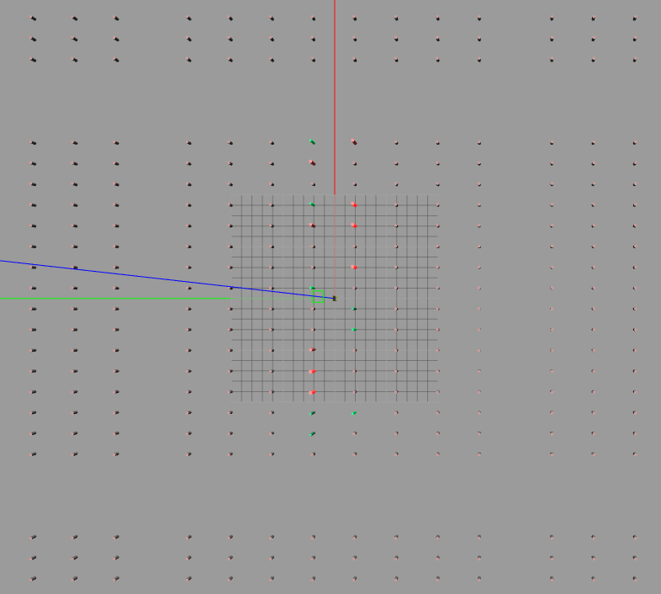
Experiment #8 : World of cylinders-original locations
Wold name: cone_orcahrd8b
World Description: mixture of cylinders, on both sides near the origin. The locations were not changed at all, all cylinders at their original positions.
Special notes: 30000 particles tested
Experiment motivation: Checking whether heterogeneity in the cylinder’s diameter alone shall lead the AMCL algorithm to a valid localization solution

Slide 37
Experiment #8 : World of cylinders-original locations
Results: 10 successive simulations- 0/10(0%) success rate . I stopped there. In two cases the algorithm managed to get the right Y coordinate.
Example success graph:-N.A

Slide 38
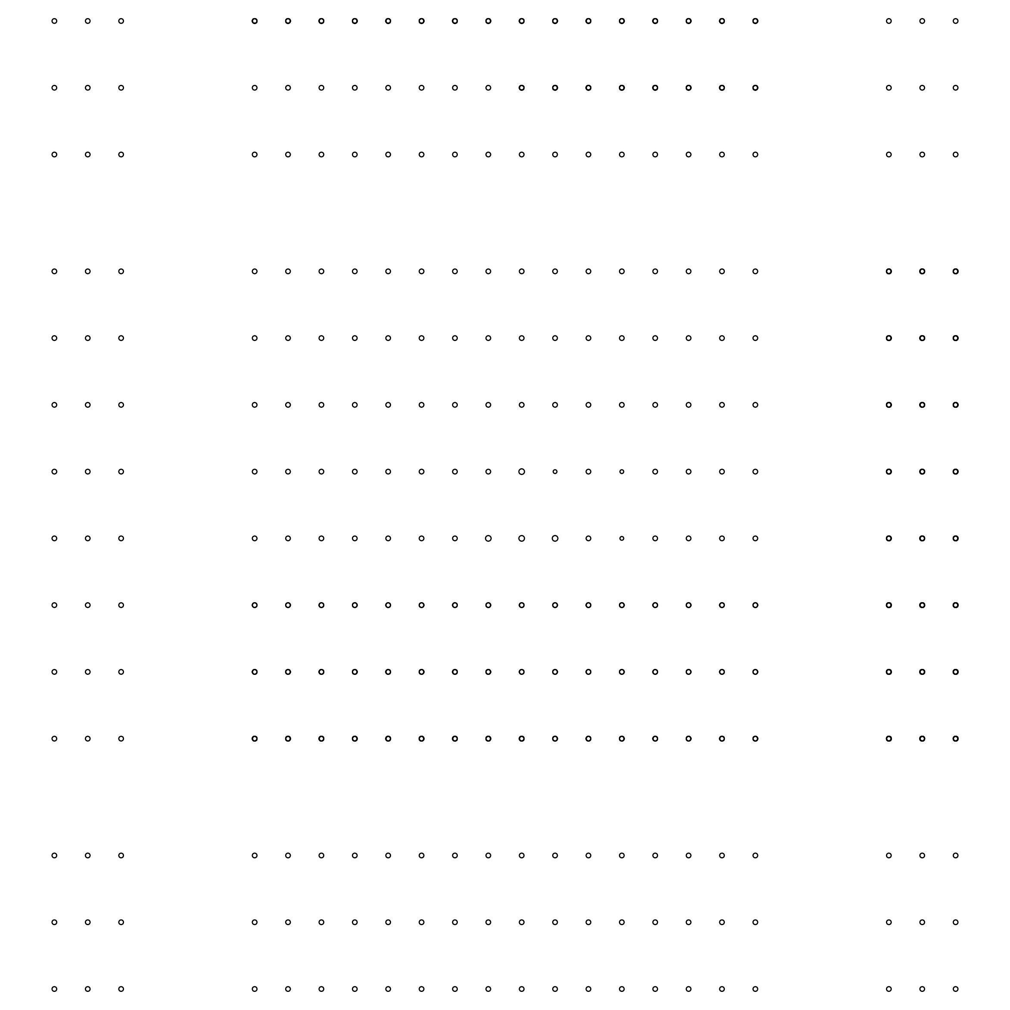
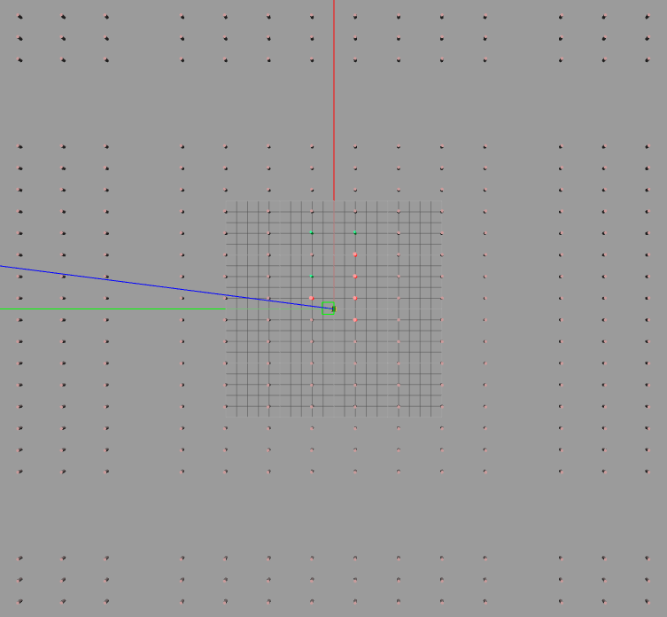
Experiment #9 : World of cylinders-original locations
Wold name: cone_orcahrd8e
World Description: mixture of cylinders, on both sides near the origin. The locations were not changed at all, all cylinders at their original positions.
Special notes: 30000/4000 particles tested
Experiment motivation: Checking whether heterogeneity in the cylinder’s diameter alone shall lead the AMCL algorithm to a valid localization solution

Slide 39
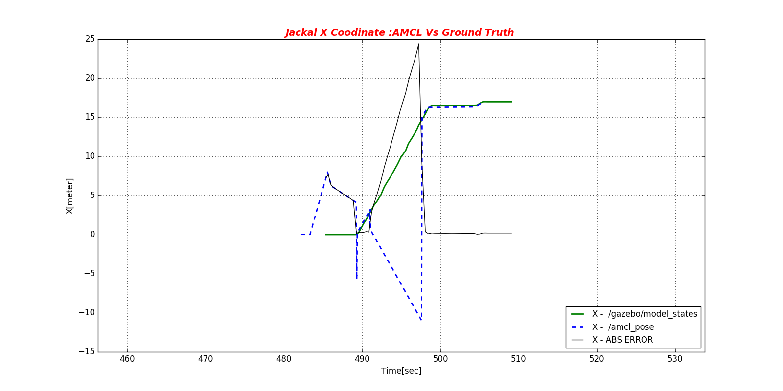
Experiment #9 : World of cylinders-original locations
Results: 5 successive simulations with 30,000 particles- 0/5(0%) success rate . I stopped there. 5 with 40,000 particles- 3/5 (60%) success in finding the true X coordinate only.
Example success graph below (X coordinate only)

Slide 40
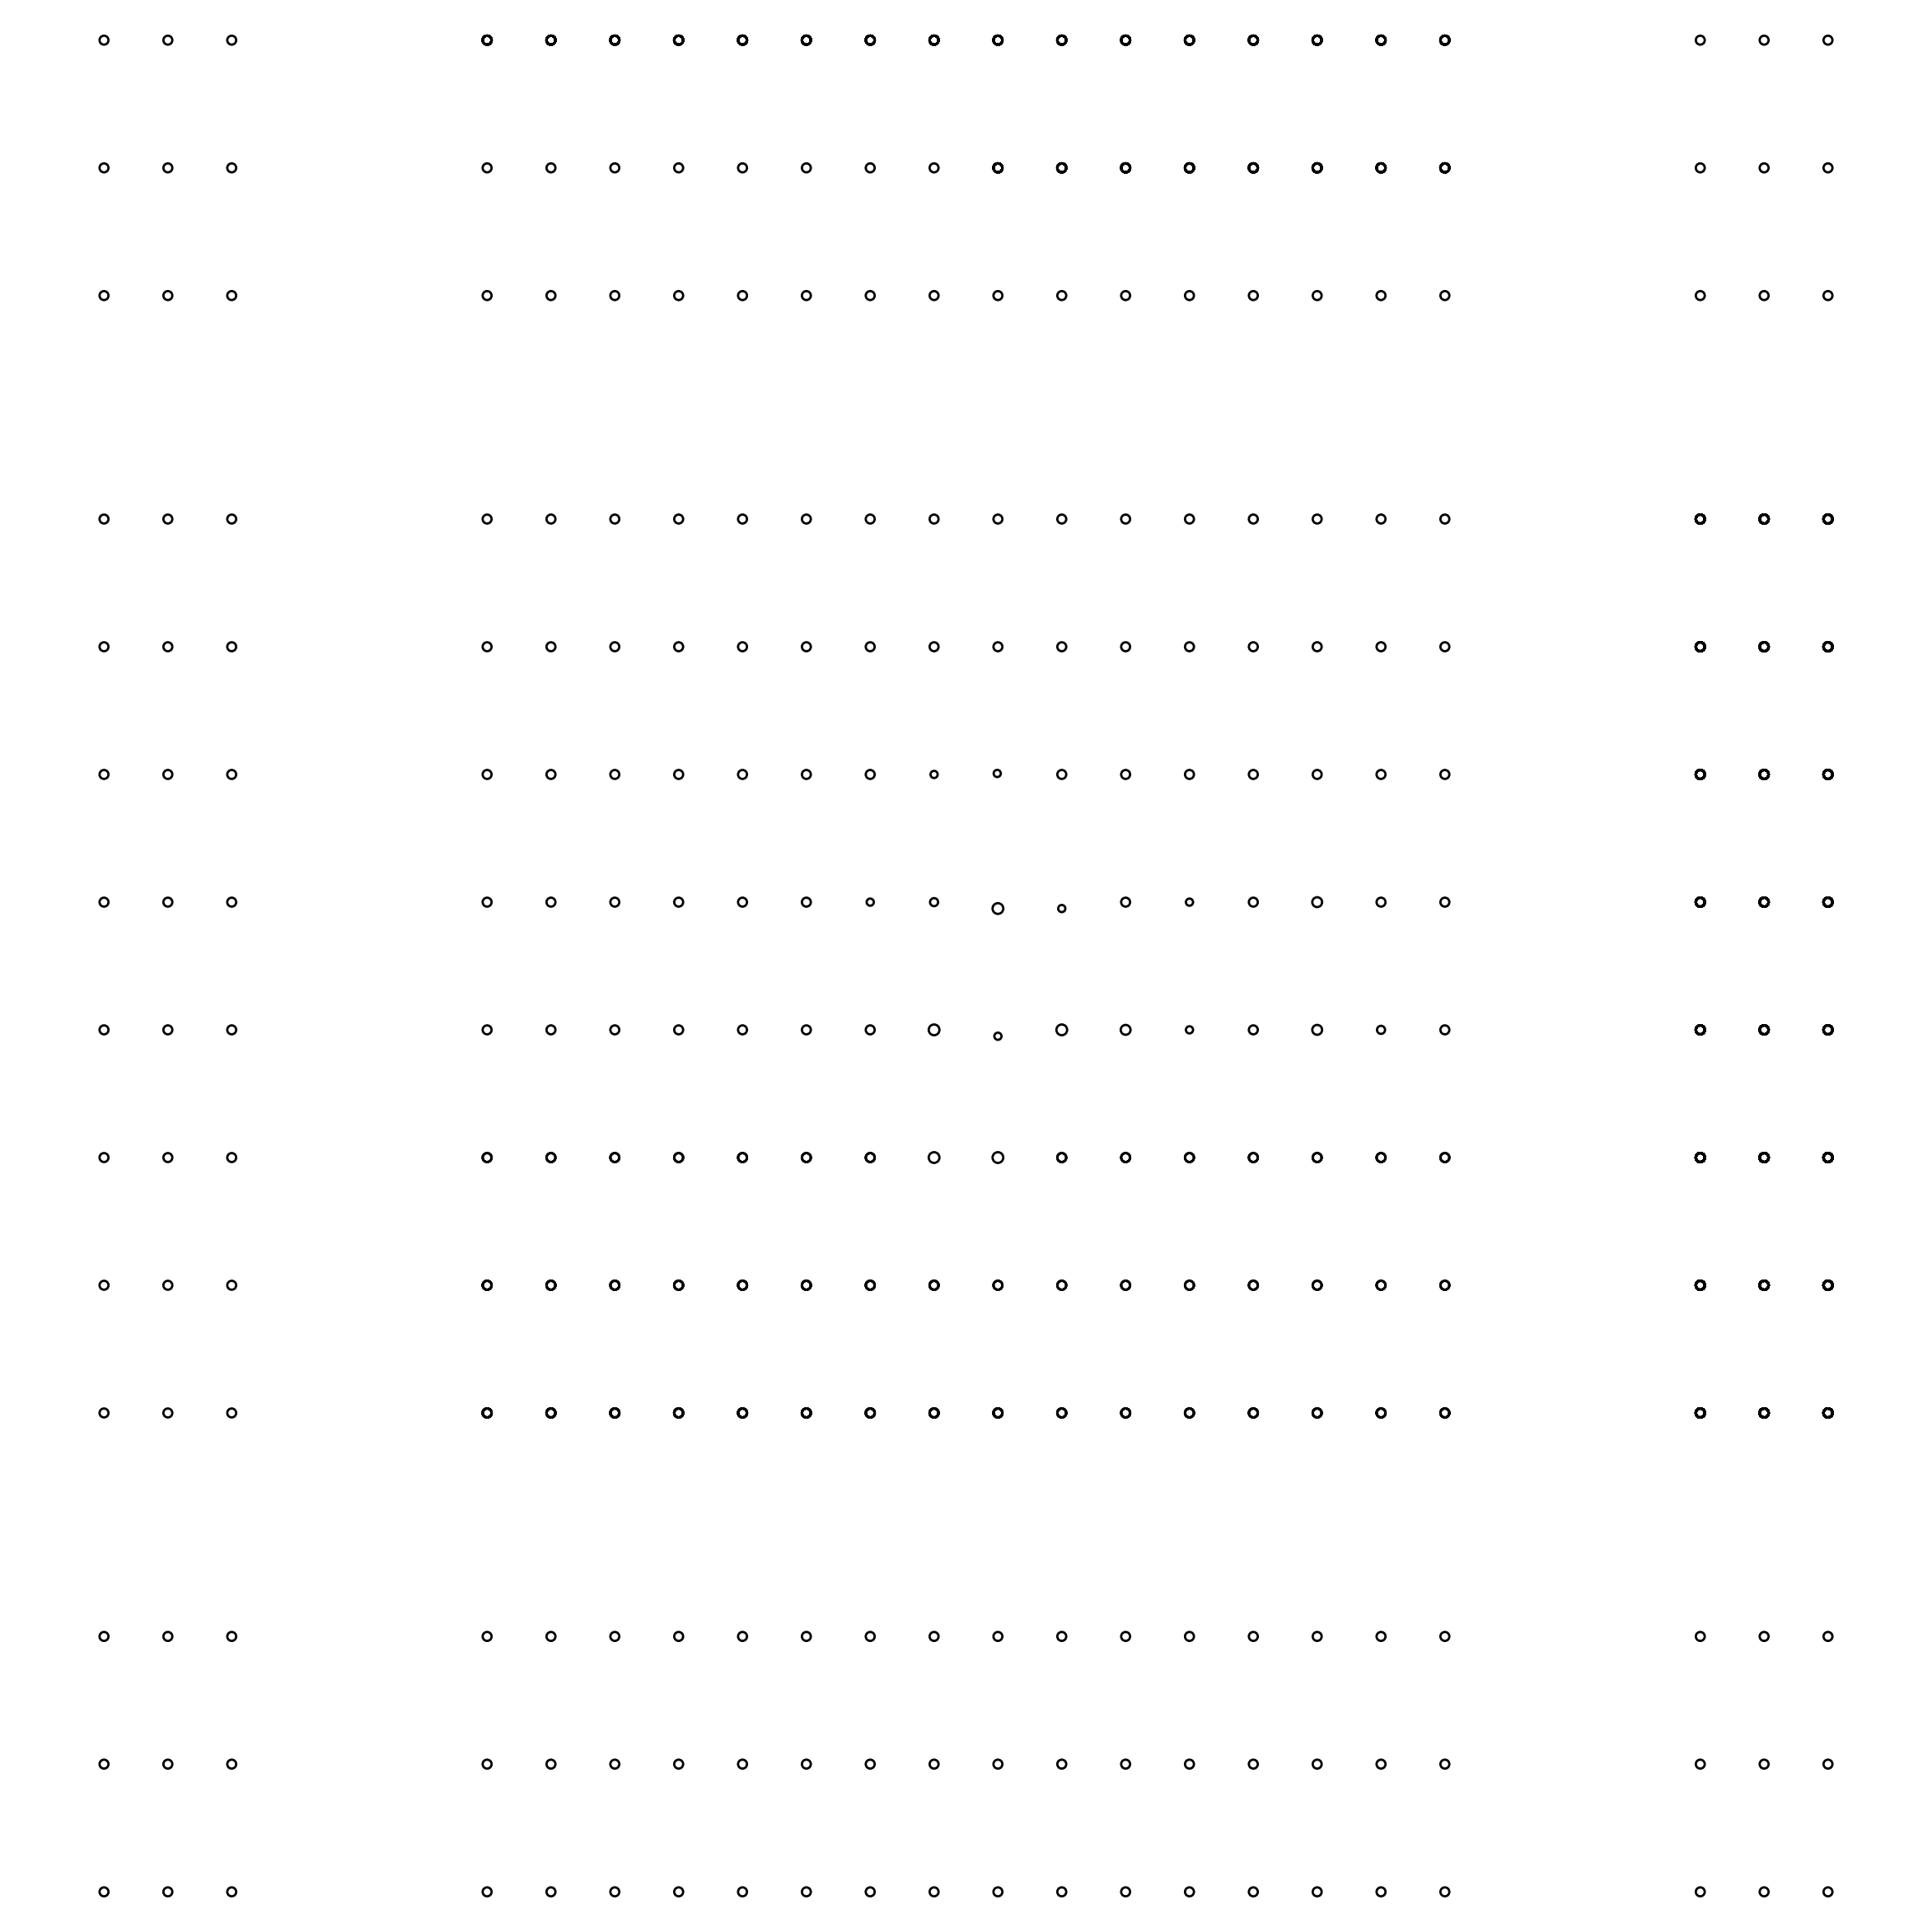
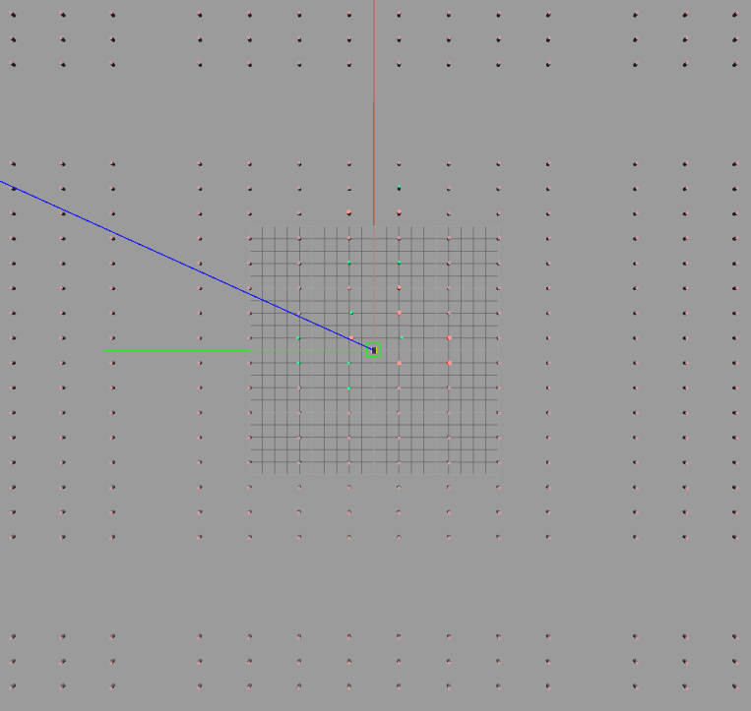
Experiment #10 : World of cylinders
Wold name: cone_orcahrd8ga
World Description: mixture of cylinders, on both sides near the origin. Adding variance of +-20[Cm] to some of the trees location near the origin.
Special notes: 30000/4000 particles tested
Experiment motivation: Checking whether heterogeneity in the cylinder’s diameter and locations lead the AMCL algorithm to a valid localization solution

Slide 41
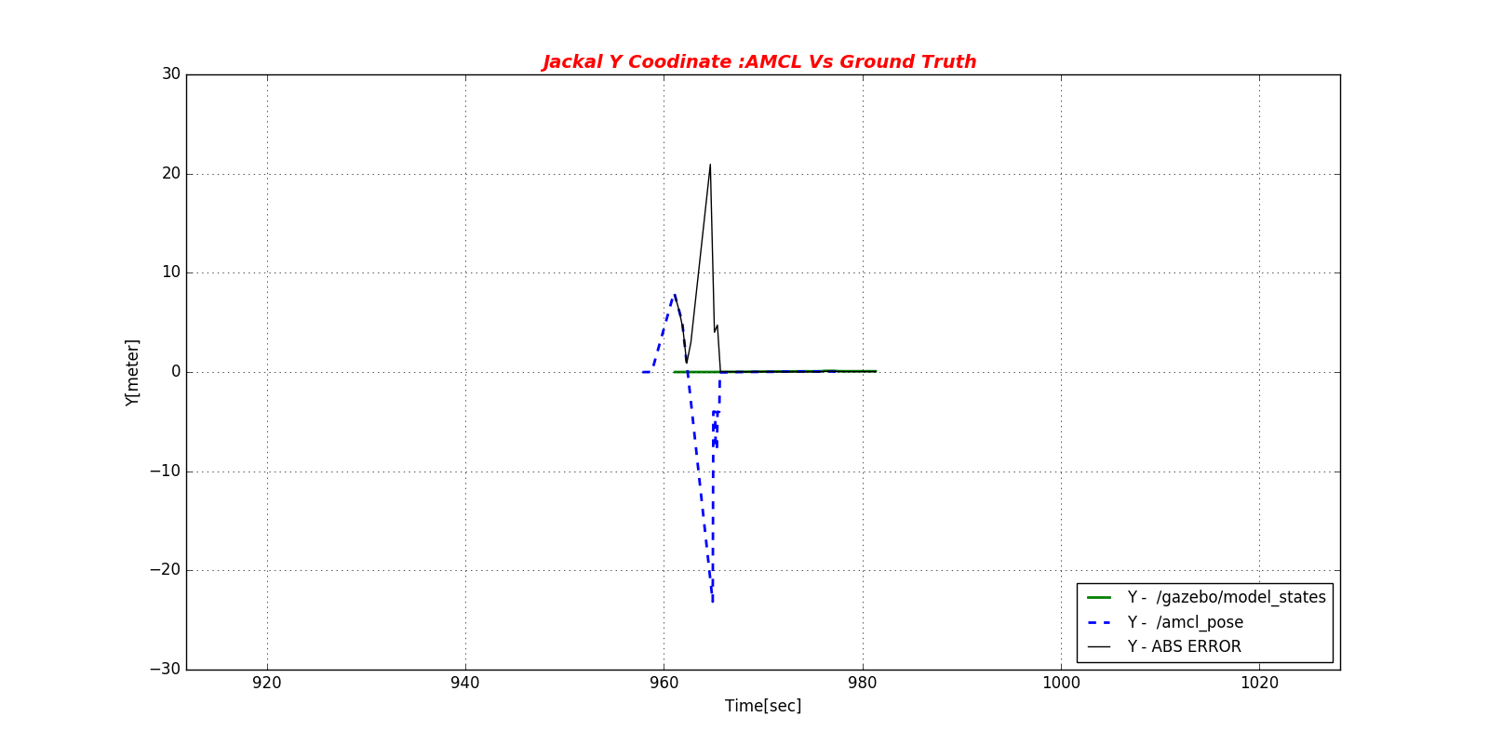
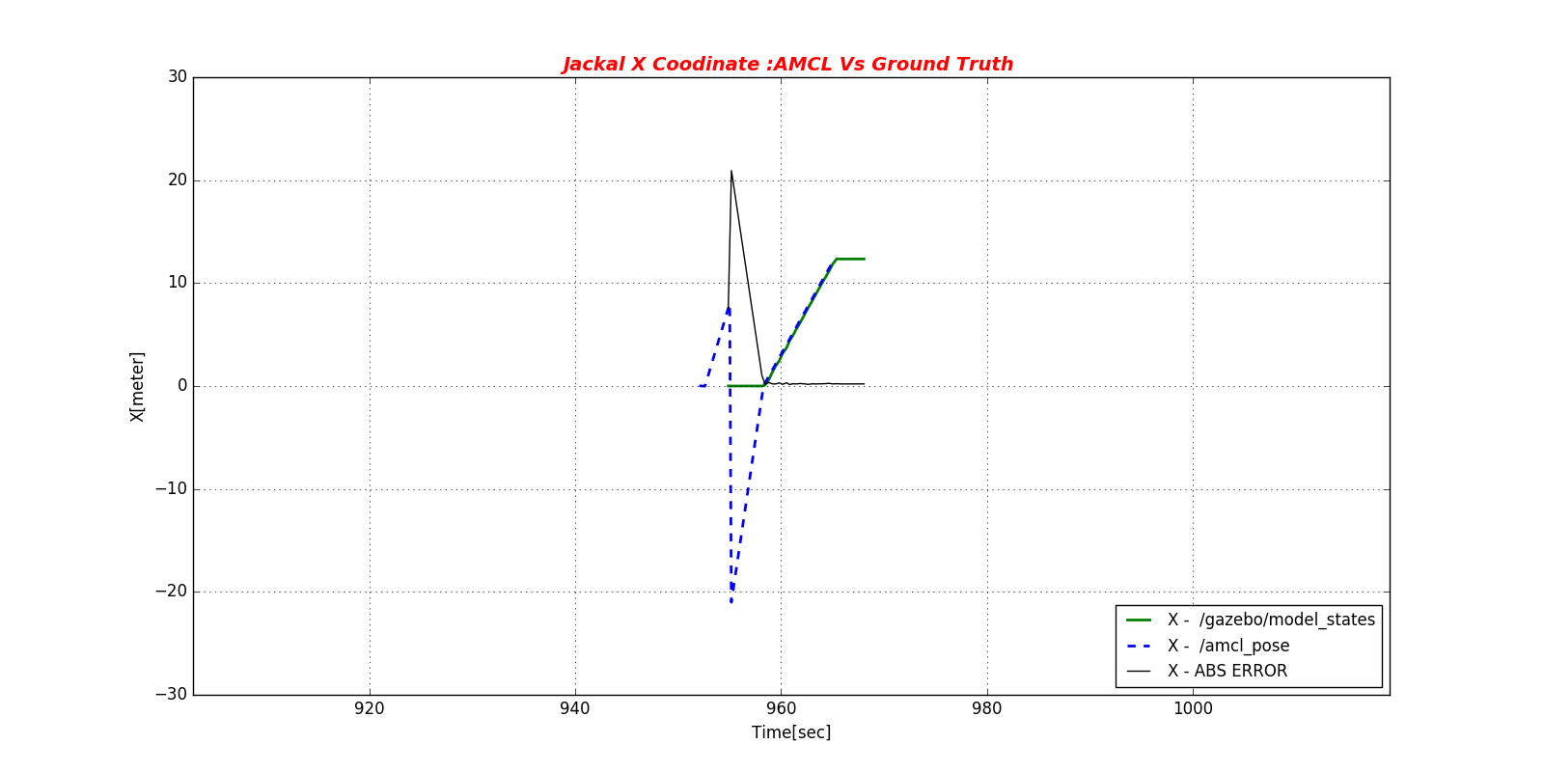
Experiment #10 : World of cylinders
Results: 16 successive simulations- 8 with 30,000 particles- 4/8 (50%) success in finding the true Y coordinate only. 8 with 40,000 particles- 6/8 (75%) success in finding the true X coordinate only.
Example success graph below- the graphs are from different experiments

Slide 42
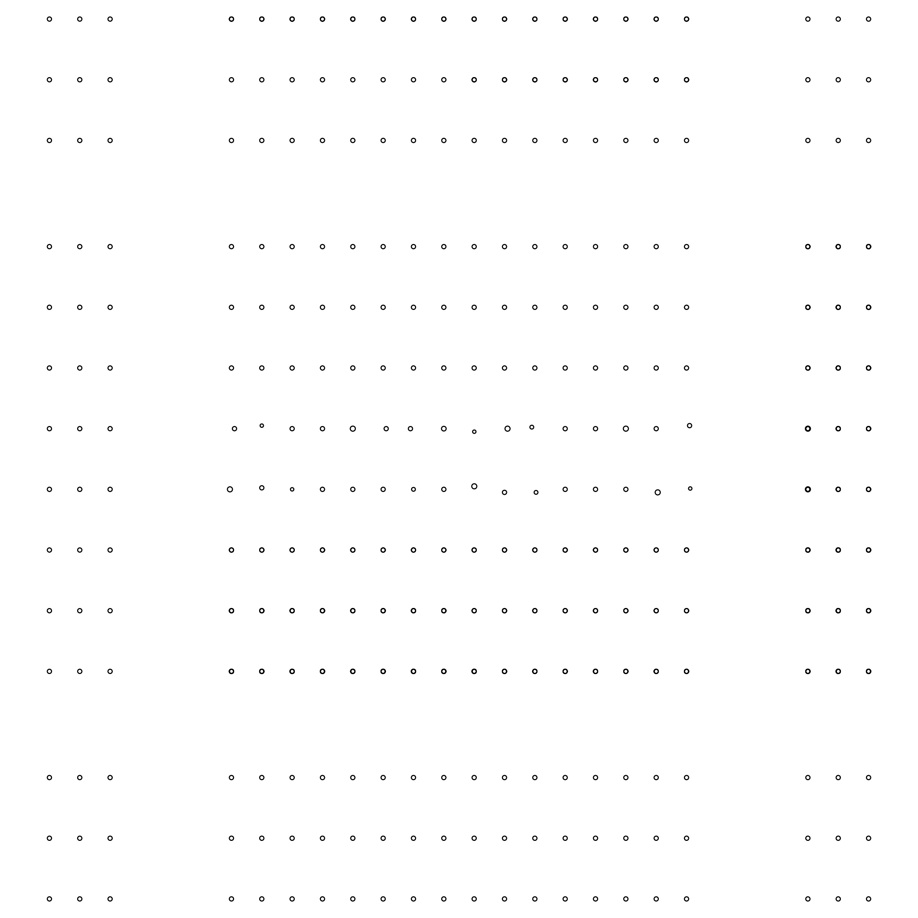
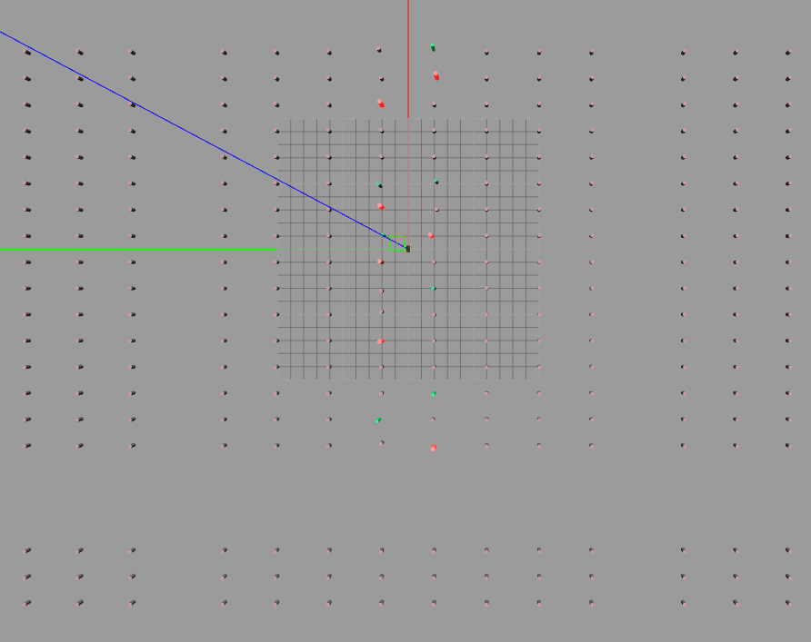
Experiment #11 : World of cylinders
Wold name: cone_orcahrd8gc
World Description: mixture of cylinders, on both sides near the origin. Adding variance of +-20[Cm] to some of the trees location near the origin.
Special notes: 30000/4000 particles tested
Experiment motivation: Checking whether heterogeneity in the cylinder’s diameter and locations lead the AMCL algorithm to a valid localization solution

Slide 43
Experiment #11 : World of cylinders
Results: 14 successive simulations-0/14 (0%) success rate.
Example success graph- N.A

Slide 44
Conclusions and insights-experiments 8-11
“Natural” Heterogeneity in the cylinder’s diameter alone is not enough. From experiments 8 and 9 it is quite clear that the variance of +-20% in the cylinder’s diameter is not enough for the AMCL to determine the robot’s location. The cylinders looks nearly identical in the map and to the laser scanner.
Adding variance in the cylinder’s coordinates (+-20cm) is also not enough, but may improve the results. From experiment 10 we can see that changing the locations of the cylinders may lead to some good “half” solutions (meaning, finding the true X or Y coordinate). Yet, even with 40,000 particles (where my PC was sweating) – a valid location solution in both coordinated was never found despite the larger heterogeneity introduced by moving the cylinders from their original positions. Experiment 11 is similar to 10 but yielded null results. It shows that the even the partial success of experiment 10 is still “fragile” and highly dependent on a specific arrangement of the cylinders. In short, The heterogeneity introduced by +-20cm in location and +-20% of cylinder’s diameter is simply too small for the AMCL.

Slide 45
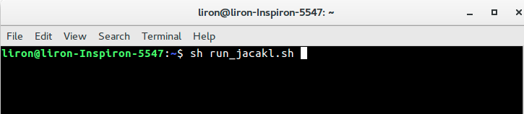
Project Structure and general info
All project files are in jackal_navigation dir, inside linux user’s home directory.
Directory contents in based on jackal navigation stack from CLEARPATH® website
https://www.clearpathrobotics.com/assets/guides/jackal/simulation.html downloaded from source
Project is running on UBUNTU 16 (Xenial) using ROS Kinetic and Gazebo 7.2
Single Command running
    There are two linux scripts inside the user’s home directory:
      run_jacakl.sh - calls all launch files, python scripts, etc.
      mybash.sh – used from creating a new map. Usually called from run_jacakl.sh and not by the user.
    Please install Terminator software on your machine as the scrips uses it.
    Running example:

Slide 46
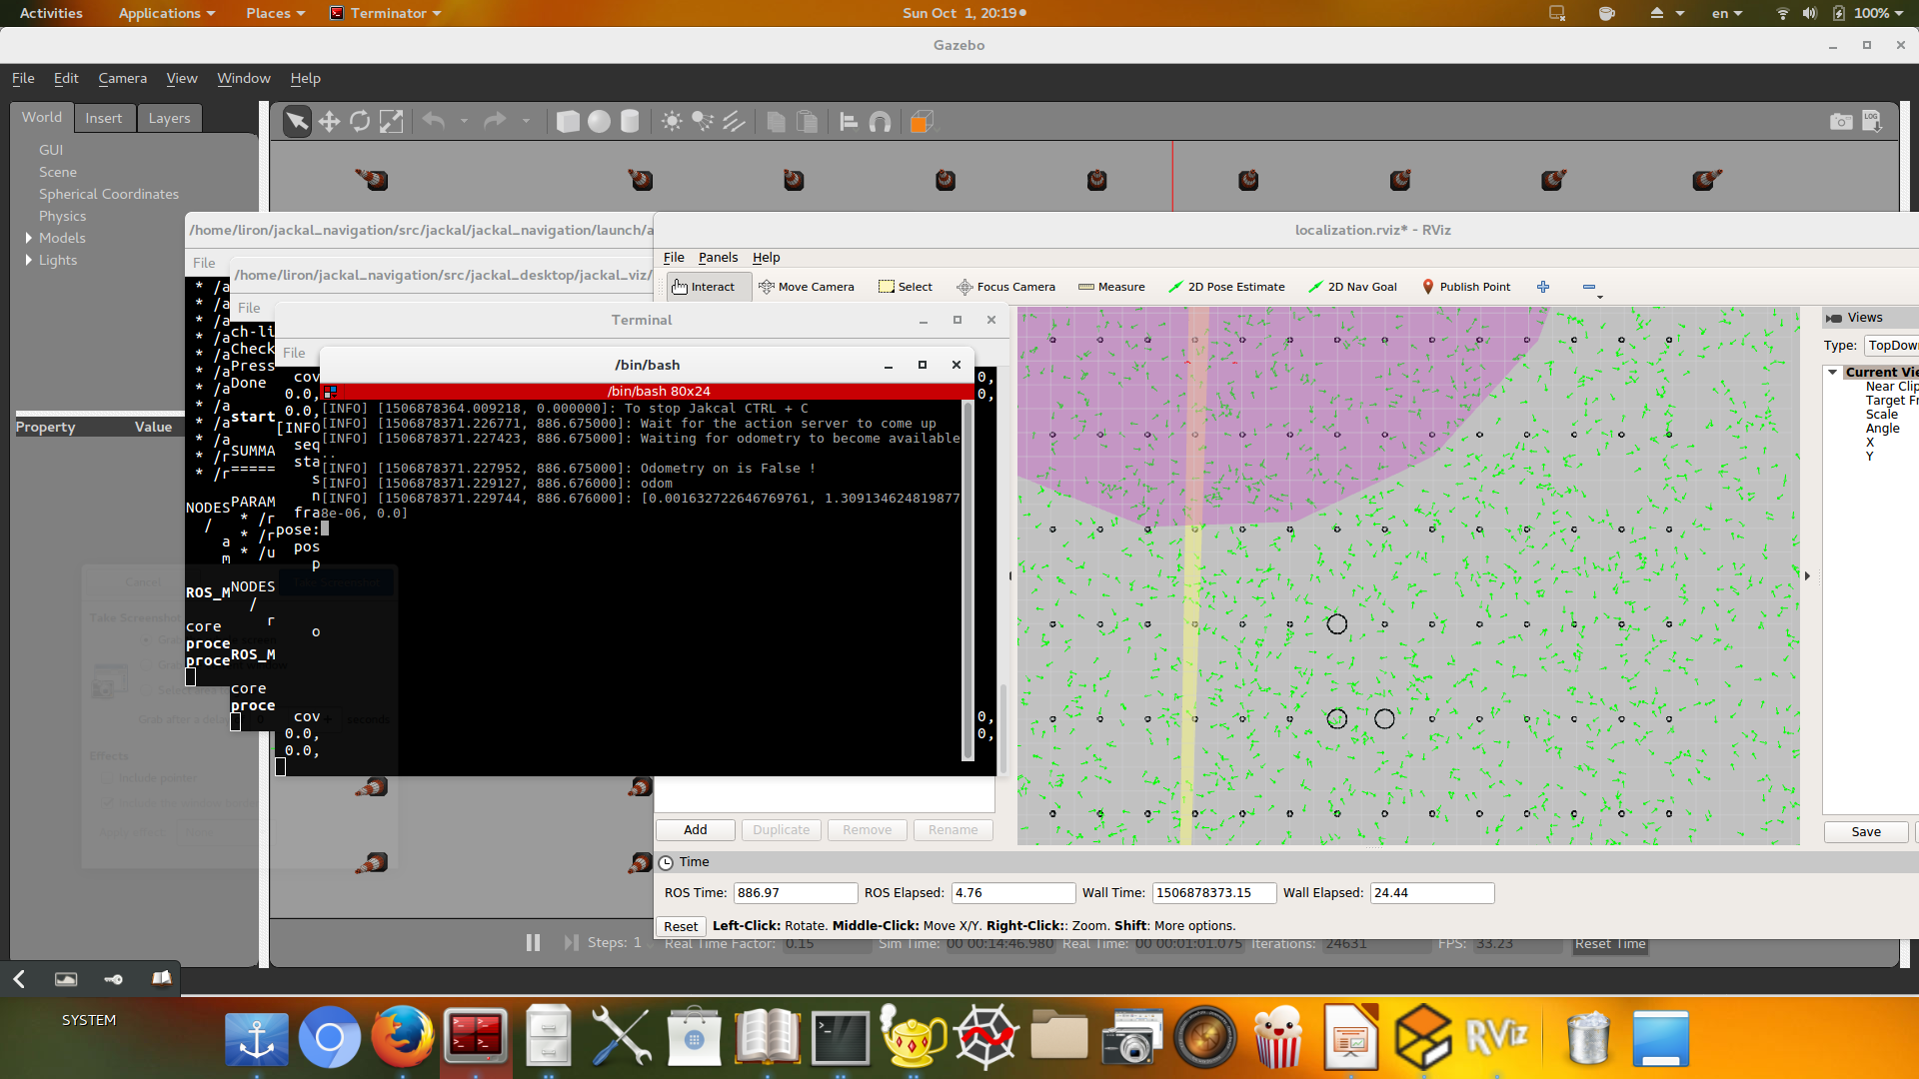
Project Structure and general info
What happens when the run_jackal script is invoked?
In short-Everything. The high level of automation was a key principle of the project since it enables to run many successive simulations easily and get the results rather quickly.
Several terminals are opened one after the other- among them the Gazebo and the Rviz windows. The robot starts moving and the AMCL node is being launched.

Slide 47

Project Structure and general info
What happens when the run_jackal script is invoked (cont.)?
A script moves the robot in the path shown below- heading forward and rightwards, and than travel between the orchard’s columns.
Due to angular errors caused by odometry inaccuracy and timing Inaccuracies of the Gazebo simulator, the jackal always bumped into a cone. The actual path was not consistent, even when running successive simulations under the same conditions.
Even though- Understanding of the AMCL behavior and the ability of gathering insights about its performance remained intact.
The “heart” of the problem was the AMCL
global localization, which Is invoked
immediately, usually before the above errors
takes a significant place.

Slide 48


Project Structure and general info
What happens when the run_jackal script is invoked (cont.)?
In order to stop the robot, one has to terminate (CTRL+C) the Terminator window seen below.
In order to create maps (explained in the coming slides) , one has to terminate (CTRL+C) the terminal seen below.

Slide 49

Project Structure and info
run_jackal.sh file structure:

Slide 50

Project Structure and info
run_jackal.sh file structure (Cont.):

Slide 51

Project Structure and info
Folder Structure is shown on the diagram on the right.
The worlds and launch files are exactly where they are on the navigation stack.
One added package called my_pkg using Catkin make.
The package contains mainly python scripts and maps.
The maps folder contains maps and graphs.
Graphs are created automatically after every
simulation is terminated using ctrl+c.
Maps are created if the flag “create_map” on
run_jackal script is set to true.

Slide 52


Project Structure and info
What’s inside maps dir?
Each folder carries the name of the Gazebo world on
which the simulation is being running on.
When running the simulation,several terminals are opened:
for gazebo, Rviz, AMCL and some other nodes.
When terminating the AMCL terminal
(Ctrl+C) - graphs are created automatically
and saved inside the appropriate folder.

Slide 53
Project Structure and info
What’s inside maps dir (cont.)?
The graphs created are:
  X vs time- ground truth
  Y vs time- ground truth
  X vs time- ground AMCL
  Y vs time- ground AMCL
  X vs time- ground truth & AMCL
  Y vs time- ground truth & AMCL
  X Y ground truth & AMCL (trajectory - no time)

Slide 54


Project Structure and info
What’s inside maps dir?
There are copies of the world and launch files from the jackal_gazebo directory.
Two images .pgm & .png which are the ground truth map. Both can be used.
Text files of the ground truth/AMCL messages
after parsing.
worldname.txt – used for creating the map.
.yaml file- used by Rviz for reading the map properly.
map

Slide 55

Project Structure and info
Amcl.launch file
The amcl.launch file in the navigation stack contains all the parameters needed for the AMCL node.
Important! - The parameters were adjusted carefully . Please read http://wiki.ros.org/amcl , and especially https://answers.ros.org/question/227811/tuning-amcls-diff-corrected-and-omni-corrected-odom-models/

Slide 56
Project Structure and info
Project location
One has to first install the jackal_navigation stack and then add my_pkg package using Catkin_make
What appears on Github is only
  my_pkg directory (with the scripts and maps)
  package.xml & Cmakelists.txt that should be added to my_pkg folder
  worlds & launch files directories (their content should be copied to the same folders inside the navigation stack)
  Presentation folder, where this presentation is being stored.
  sh_files folder- for bash scripts. These should be copied to the user’s home directory.
  Videos
  Cylinder models
Github : https://github.com/sliri/my_pkg.git

